Slide 1
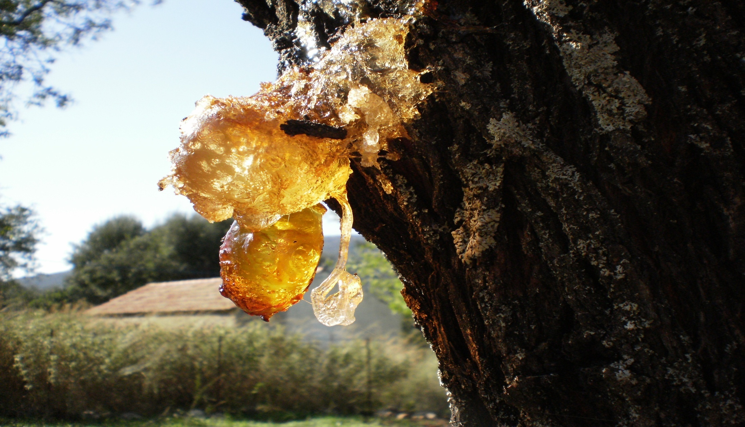
terpenes
PRESENTED BY
a. VAMSI M.Pharm
Department of pharmaceutical chemistry
M.A.M college of pharmacy
Narasaropet

Slide 3
Terpenes & terpenoids
The name "terpene" is derived from the word "turpentine“
Terpene is a natural organic compound mainly synthesized by plants their odour, flavour, and in some cases colour
when the plant source is distilled with steam, the oily materials so obtained are called essential oils
Terpenoids are hydrocarbons of plant origin of the general formula (C5H8 )n as well as their oxygenated, hydrogenated and dehydrogenated derivatives.

Slide 4
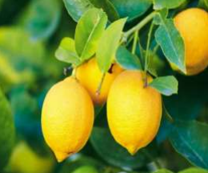
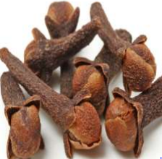
Examples of terpenoids :
Geraniol, Citronellol, Farnesol
Limonene, Citral
Eugenol

Slide 5
PHYSICAL PROPERTIES
Terpenoids are colourless liquid
Soluble in organic solvents and insoluble in water.
Most of the terpenoids are optically active.
Volatile in nature.
Boiling point 150 – 1800 C
CHEMICAL PROPERTIES
They are unsaturated compounds.
They undergo addition reaction with hydrogen, halogen, halogen acids to form addition products like NOCl, NOBr and hydrates.
They undergo polymerization and dehydrogenation in the ring.
On thermal decomposition, terpenoid gives isoprene as one of the product.

Slide 6
ISOPRENE RULE
In 1887, Wallach proposed the isoprene rule.
“It states that the skeleton structures of all terpenoids are built up of isoprene units or 2-methyl 1,3-butadiene”.
The empirical formula of almost all terpenoids is C5H8
The thermal decomposition of all terpenoids gives isoprene as one of the products. Eg: Rubber on destructive distillation yields isoprene as the product..
EX:

Slide 7
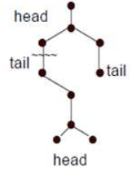
SPECIAL ISOPRENE RULE
This rule proposed by Ingold in 1925.
According to this rule “the isoprene units in terpenoids are joined by head to tail linkage or 1,4- linkage ( The branched end of isoprene unit was considered as head and other end as the tail).

Slide 8
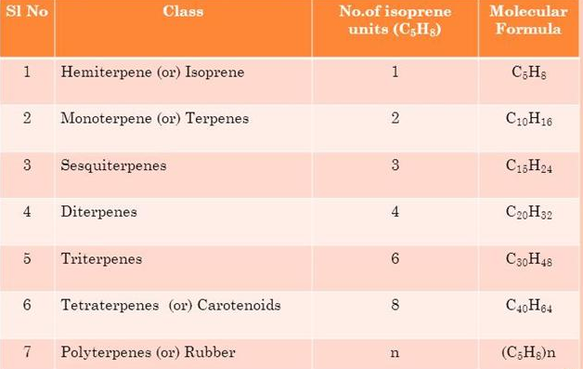
CLASSIFICATION OF TERPENOIDS
Terpenes are classified according to the no. of isoprene units(C5) in the molecule

Slide 9
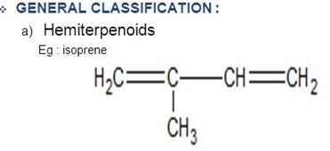
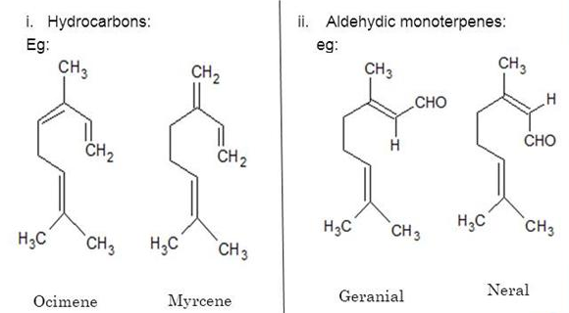
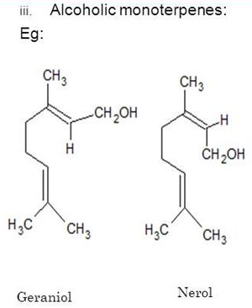
b) Acyclic monoterpenoids:

Slide 10
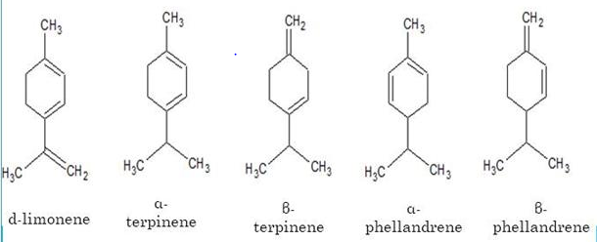
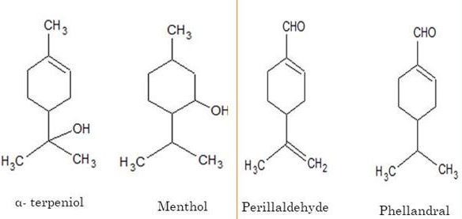
Monocyclic monoterpenoids
i) hydrocarbons:
ii) alcohols
iii) aldehydes:

Slide 11
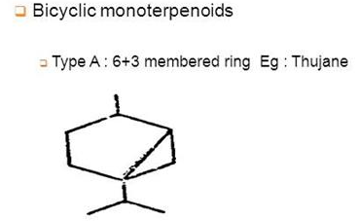
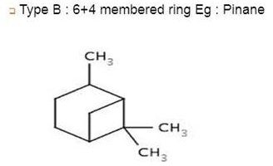
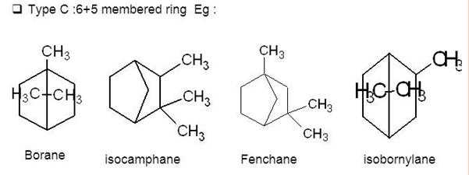

Slide 12
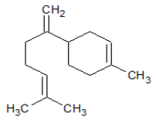
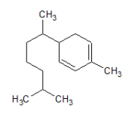
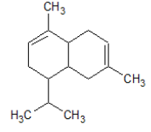
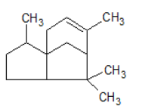
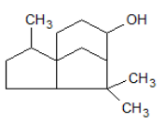
2) SESQUI TERPENOIDS
i) Acyclic sequiterpenoid
ii) Monocyclic sesquiterpenoid
iii) Bicyclic sesquiterpenoids
Farnesol
Zinziberene
Cadinene
iv) Tricyclic sesquiterpenoids
Cedrol Cedrene

Slide 13
3) DITERPENOIDS
4) TRITERPENOID
i) Acyclic diterpenoids
i) Acyclic triterpenoid
Phytol
Squalene
ii) Monocyclic diterpenoids
Vitamin A

Slide 15
ISOLATION OF TERPENOIDS
Isolation of essential oils from plant parts
a) Steam distillation method
b) Solvent extraction
c) Adsorption in purified fats/ Enfluerage
ii) Separation of terpenoid from essential oils
a) Chemical methods
b) Physical methods
a) Steam distillation method

Slide 16
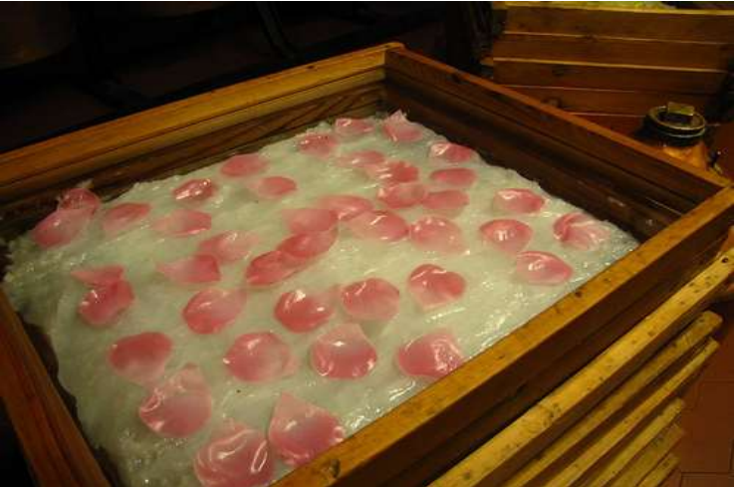
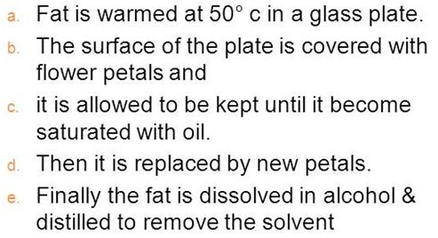
b) Solvent extraction
The plant material is directlly extracted with light petrolium or ether at room temperature
The extract is filtered and the solvent removed by evoparation and collect essential oils
c) Adsorption in purified fats/ Enfleurage
ROSE PETALS ENFLUERAGE

Slide 17
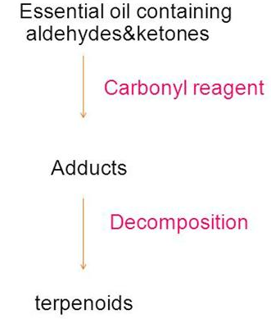
2. SEPARATION OF TERPENOID FROM ESSENTIAL OILS
a) CHEMICAL METHOD:

Slide 18
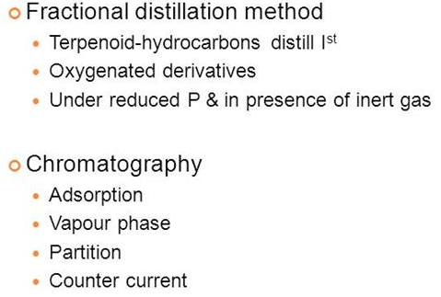
b) PHYSICAL METHOD

Slide 19
GENERAL METHODS OF STRUCTURAL ELUCIDATION OF TERPENOIDS
Analytical method
Synthetic method
Physical method
4. Molecular rearrangement
5. Synthesis
1) ANALYTICAL METHOD
a) Molecular formula ----------------→
b) Nature of the oxygen atom
c) Unsaturation
d) Number of rings
e) Oxidative degradation products
f) Dehydrogenation
Qualitative method
• Quantitative method
• Mass spectroscopy

Slide 20
ii) Nature of oxygen atom present:
If oxygen is present in terpenoids its functional nature is generally as alcohol aledhyde, ketone or carboxylic groups.
a) Hydroxyl group: presence of –OH group can be determined by the formation of acetates with acetic anhydride and benzoate with 3.5-dinitirobenzoyl chloride.
Primary alcoholic group undergo esterification more readily than secondary and tertiary alcohols.

Slide 21
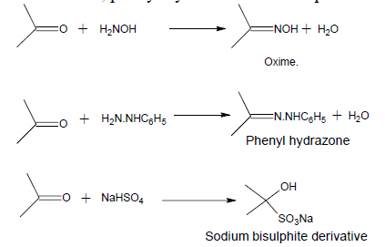
b) Presence of carbonyl group: Terpenoids containing carbonyl function form crystalline addition products like oxime, phenyl hydrazone and bisulphite etc
Carbonyl group : Aldehyde or Ketone
If carbonyl function is in the form of aldehyde it gives carboxylic acid on oxidation without loss of any carbon atom whereas the ketone on oxidation yields a mixture of lesser number of carbon atoms.

Slide 22
c) Unsaturation
• It is determined by the formation of addition products with reagents like hydrogen, halogen, halogen acids, per acids and nitrosyl chloride.
Eg: Cadinene undergo hydrogenation to form tetrahydro cadinene, it indicate that cadinene contains 2 double bond.

Slide 23
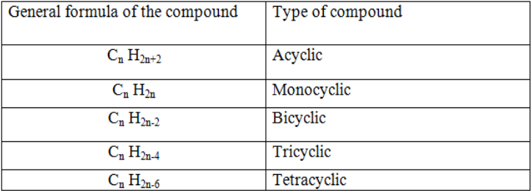
d) Number of rings
The number of rings is determined from the following table showing the relation between general formula of compound and types of compounds.
The molecular formula of citral is C10H16O, it contain 2 double bonds and one oxygen atom as carbonyl group.
Molecular formula of parent hydrocarbon is C10H16O ≡ C10H16 + 4H (for 2 double bond) + 2H (for carbonyl oxygen) ≡C10H22.
The molecular formula C10H22 corresponds to Cn H2n+2 (general formula of acyclic terpenoid), so citral is an acyclic terpenoid

Slide 24
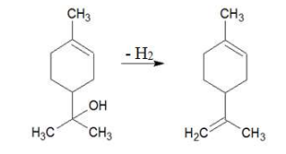
e) Oxidative degradation products
Ozone: Terpenoid react with ozone to form ozonide it undergo decomposition either hydrolysis or catalytic reduction yields carbonyl compounds.
Nitric acid : Terpenoids react with nitric acid to form aromatic acid and aliphatic acid.
f) Dehydrogenation
Ex: α-terpeneol to dipentene.

Slide 25
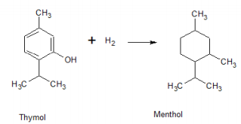
2) SYNTHETIC METHOD
Catalytic Hydrogenation
When aromatic compounds undergo catalytic hydrogenation to form synthetic terpenoids.
Eg: Menthol is prepared from thymol an aromatic compound by catalytic hydrogenation

Slide 26
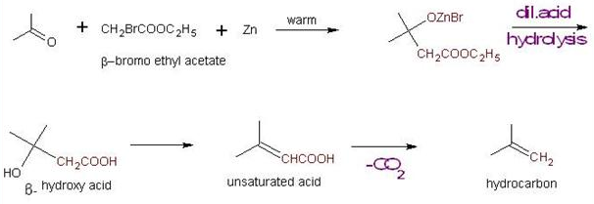
b) Grignard reactions
In grignard reagent, methy or isopropyl groups are introduced into compound having carbonyl groups to synthesise large number of terpenoids.
c) Reformatsky reactions
In this reaction - halogen substituted ester is treated with a carbonyl compound to form - hydroxyl ester. It is then treated with dil.acid yield - hydroxyl acid which further coverted to an unsaturated acid or a hydrocarbon.

Slide 27
3) PHYSICAL METHOD
UV spectroscopy:
It is used for the detection of conjugation in terpenoids
IR spectroscopy:
Used for detecting the presence of a hydroxyl group, an oxo group.
Used for distinguish between cis and trans isomer.
Used for quantitative measurements (determination of no: of methyl group).
NMR spectroscopy:
Used for identifying double bonds and determing the nature of end groups in terpenoid.
No: of rings present in terpenoid
Orientation of methyl group in terpenoid
Presence of –OH group
Mass spectroscopy:
mol. wt and mol. Formulae
nature of functional group and position of double bonds

Slide 28
4) MOLECULAR REARRANGEMENT
• Molecular rearrangement is used when the degradation reaction gives various products.
• 5) SYNTHESIS
• Structure elucidated by the above physical and analytical method is confirmed by its synthesis.

Slide 29
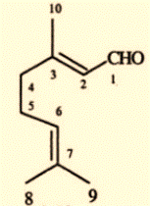
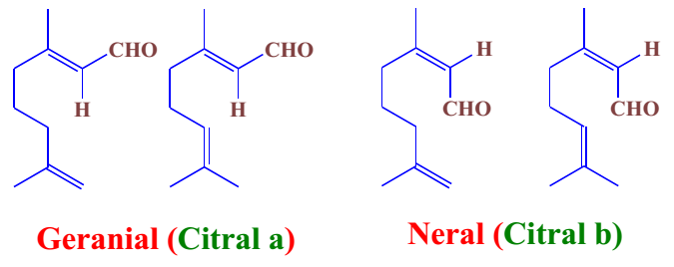
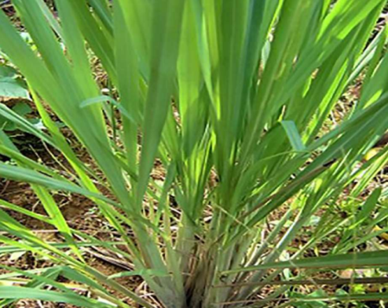
CITRAL
3,7-dimethyl-2,6-octadienal
Citral, or 3,7-dimethyl-2,6 octadienal is either a pair ,or a mixture of terpenoides with the molecular formula C10H16O
It’s the most important acyclic (open chain) mono terpenoid.
citral is the major constituents of lemon grass oil. It is also present in the oil of citrus fruits (citron, orange, lemon)
Chemically, citral is a mixture of two aldehyde that have the same molecular formula but different structures. The two compunds are found in citral which are double bond isomers. The E- isomer is know as geranial or citral A The Z- isomer is know as neral or citral B

Slide 30
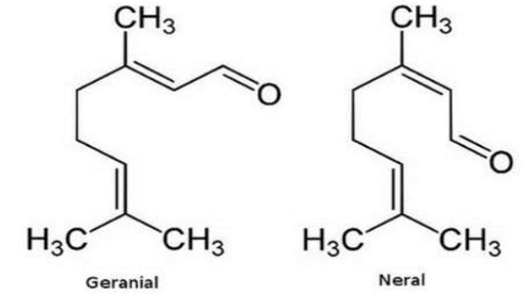
The isomer geranial has strong lemon odor.
• The isomer neral has less lemon odor and sweeter.
properties:
citral is a clear yellow colour liquid
it has strong lemon-like odour
insoluble in water
melting point is <-10˚C
citral is not stable to alkanes and strong acids
When heated to decomposition it emits acrid smoke and irritating fumes

Slide 31
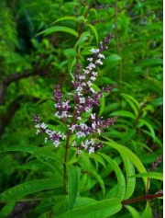
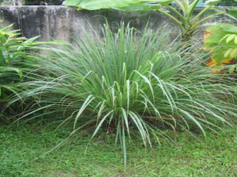
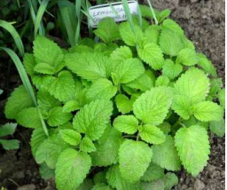
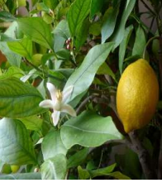
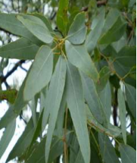
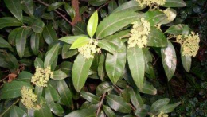
Occurrence
Citral is present in the oils of several plants including
Lemon balm (11%) Lemon (2-5%) Lemon iron bark
(26%)
Lemon grass
(65-85%)
Lemon verbena
(30-35%)
Lemon myrtle (90-98%)

Slide 32
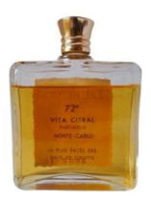
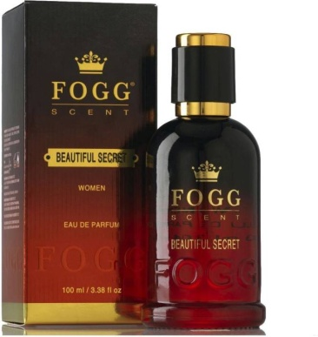
applications
It is used in perfumes and flavorings and in the manufacture of other chemicals.
Citral also has a significant role in the production of vitamin A.
Citral has strong antimicrobial qualities

Slide 33
Structure elucidation of citral
Molecular formula: C10H16O
Presence of two double bond:
Citral is treated with bromine or hydrogen, it forms citral tetrabromide. It indicate the presence of two double bond.
c) Presence of an aldehyde group:
Citral on reduction with Na/Hg it gives an alcohol called geraniol and on oxidation with silver oxide to yield a Geranic acid with same number of carbon atom as citral.
Indicate that oxo group in citral is an aldehyde group.

Slide 34
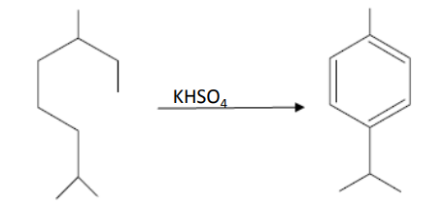
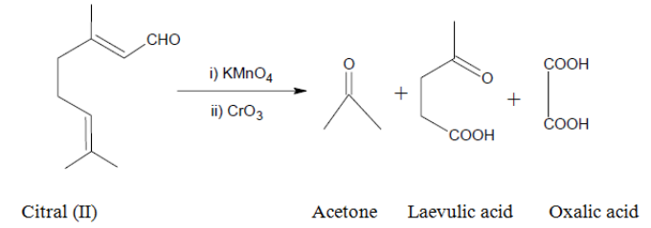
d) Carbon skeleton of citral
Citral is heated with potassium hydrogen sulphate, it gives pcymene (known compound).
e) Oxidation
Citral undergo oxidation with KMnO4 followed by chromic acid yield acetone, oxalic acid and laevulic acid. These reactions are only explained if the citral has structure (II).

Slide 35
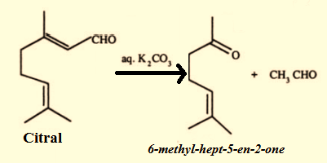
f) position of the double bond confirmed:
citral on boiling with aqueous potasium carbonate yielded to give 6-methyl hept-5-ene-2-one and acetaldehyde.

Slide 36
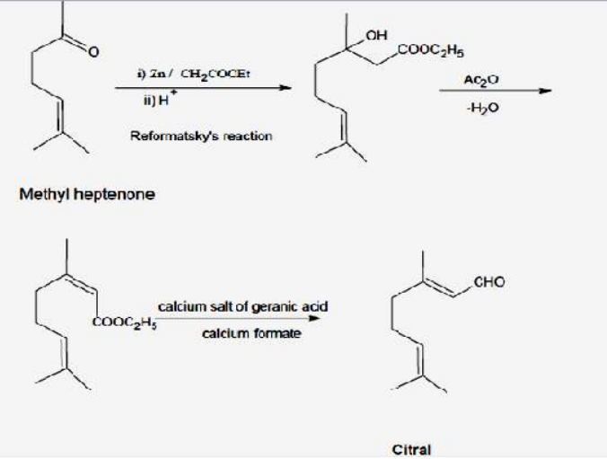
g) Confirmation synthesis of citral by Barbier-Bouveault-Tiemann’s synthesis:
In this synthesis methyl heptenone is converted to geranic ester by using Reformatsky’s reaction. Geranic ester is then converted to citral by distilling a mixture of calcium salts of geranic and formic acids.

Slide 37
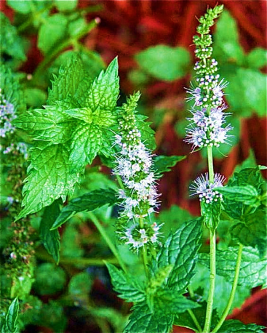
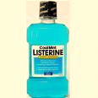
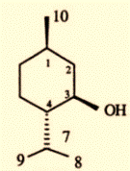
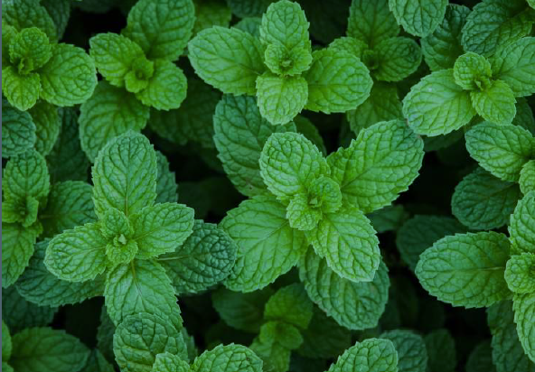
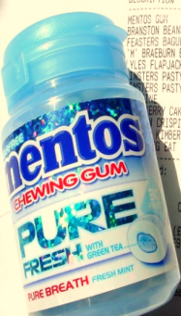
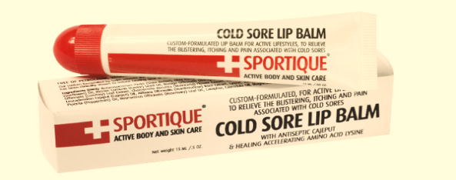
Menthol
it’s a optical active compound , present mainly in pippermint oil upto 50-60% (i.e. mentha pipertia)
menthone is obtained by addition of menthol and also occurs in essential oils of pippermint (upto 30%), geranium.
it’s a satutated compound having melting point 43˚C

Slide 38
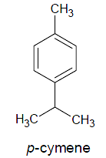
STRUCTURAL ELUCIDATION OF MENTHOL
1) Molecular formula: C10H20O
2) Menthol forms esters readily with acids it means that it possess an alcoholic group.
Menthol then oxidized to yield ketone, menthone (C10H18O) it indicate that the alcoholic group is secondary in nature
3) On dehydration followed by dehydrogenation it yields p-cymene. It indicate the presence of p-cymene skeleton (p-menthane skeleton) in two compounds.

Slide 39
4) Menthone on oxidation with KMnO4 yields ketoacid C10H18O3. It possess one keto group and one carboxyl group and is called ketomenthylic acid.
It readily oxidized to 3-methyladipic acid. These reactions can be explained by considering the following structure of menthol.

Slide 40
5) Menthol was converted to p-Cymene [1-methyl-4- isopropylbenzene], which was also obtained by dehydrogenation of pulegone.
Pulegone on reduction yields menthone which on further reduction gives menthol.

Slide 41
SYNTHESIS
Finally the structure of menthone and menthol have been confirmed by the synthesis given by Kotz and Hese from m-cresol.

Slide 42
Limonene
Limonene is most important mono terpenoid. Its an optically active liquid
it occurs in the (+), (-) as well as in the recemic forms in the latter state its known as dipentene
(+) limonene occurs in lemon, orange, caraway oils (-) limonene in pile needle and peppermint oils and (±) form (dipentene) in turpentine oil.
a large amount of limonene is produced as a by product in the citrus fruit industry.

Slide 43
constitution
mol. Formula : C10H16
from essential oils: limonene is treated with two molecules of hydrogen, bromide, HCl, and hydrogen bromide it forms tetra hydro derivative (p-menthone) , hydrochloride, dihydro bromide, tetra bromide.

Slide 44
3) From isoprene: when isoprene is heated in a sealed tube at 280˚C, diels alder reaction with itself yields (±) limonene or dipentene
Uses :
Limonene is widely employed for scenting cosmetics, soaps as well as for flavoring pharmaceuticals.

Slide 45
Geraniol
Chemical formula: C10H18O
Geraniol, also known as lemonol, Guainol, and beta-geraniol, is a mono terpenoid and a component of plant essential oils derived mainly from lemongrass, citronella, rose, lavender oils and geraniums.
The geraniol-based functional group (lacking the -OH terminal) is called geranyl.
It is an oily, pale yellow or colorless liquid with a sweet rose-like aroma. Geraniol is soluble in most organic solvents but is insoluble in water.

Slide 46
Structure elucidation of geraniol
Its molecular formula was established as C10H18O. Molecular Weight: 154,25 g/mol
Catalytic hydrogenation yielded a tetrahydro derivative C10H22O indicating the presence of two double bonds.
the formation of a tetrabromide when treated with bromine
On oxidation geraniol afforded citral. which on reduction gave two alcohols.

Slide 47
Geraniol and nerol are geometrical isomers.
Both geraniol and nerol gave the same tetrahydro derivative on catalytic hydrogenation.
Both of them underwent cyclisation to give terpeneol by the action of sulphuric acid and the rate of cyclisation in the case of nerol was 9 times faster compared to that of geraniol.
Based on this Δ 2 -double bond in nerol was assigned as cis while the same double bond in geraniol as trans.

Slide 48
REFERENCES
“Organic chemistry of natural products” ; volume I; GURUDEEP AND CHATWAL; page no: 1.1 – 1.155
“ Organic chemistry of natural products” volume : I; O.P AGARWAL; Page no: 312-433
“A text book of organic chemistry” multi colour edition; Baul and Baul; page no: 884-887.
https://slideplayer.com/slide/10026518/
https://www.slideshare.net/ShvetaArya/chemistry-of-naturalproducts

Slide 49
Thank You

