Slide 1
CARBOHYDRATES
ALETI VAMSI

Slide 2
Introduction
carbohydrates General molecular formula Cn (H2O)n, that makes them seem to be Hydrates of carbon
Composed of carbon, hydrogen and oxygen. Some carbohydrates contain Sulphur, Nitrogen or Phosphorus
The term carbohydrates and sacharides (sugars) are closely related Carbohydrates are the most abundant organic molecules in nature.
Carbohydrates are sugars and provide energy when consumed. Our bodies break down carbohydrates to extract energy. Carbon dioxide and water are released in the process.
Most important carbohydrate in the body glucose. Its the primary carbohydrate our bodies use to produce energy.
Carbohydrates are classified as biomolecules.
Simple carbohydrates are referred to as simple sugars and are often sweet to the taste.
Consumption of more sugar than is needed for energy results in conversion of these sugars to fat.
Complex carbohydrates include starches and the plant and wood fibers known as cellulose.

Slide 3
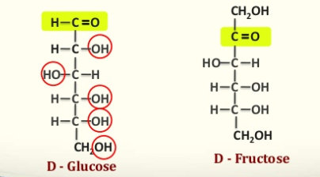
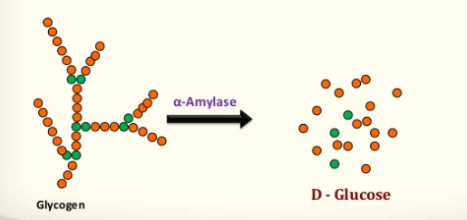
Definition:
Carbohydrates are defined as poly hydroxy aldehydes or ketones or compounds which produce them on hydrolysis.

Slide 4
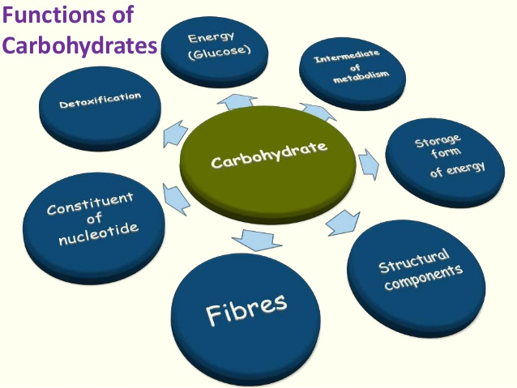

Slide 5
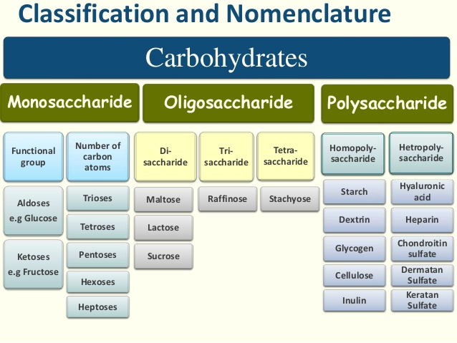

Slide 6
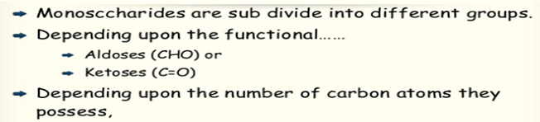
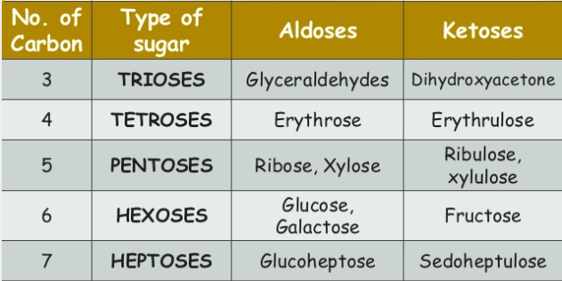
Mono saccharides (one + sugar)

Slide 7
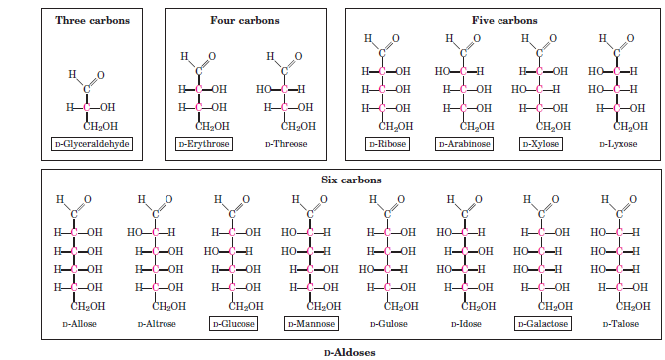

Slide 8
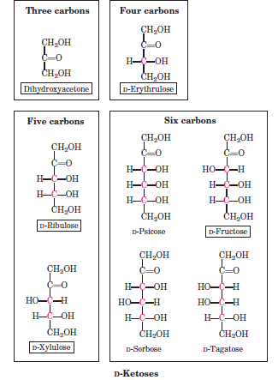

Slide 9

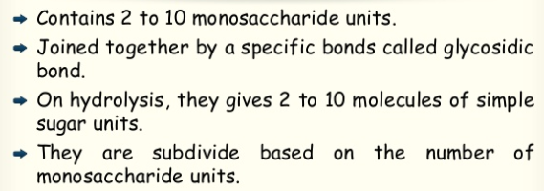
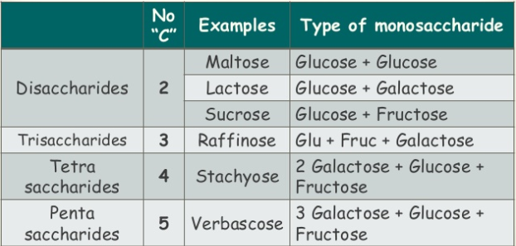

Slide 10
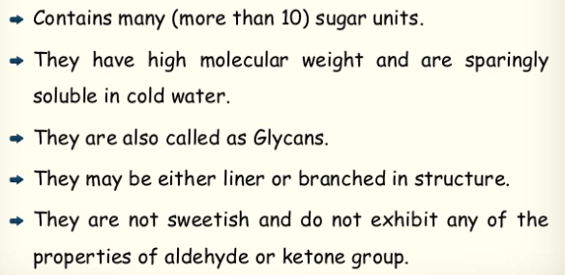
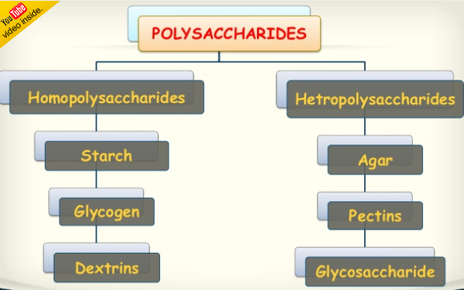
Polysaccharides

Slide 11
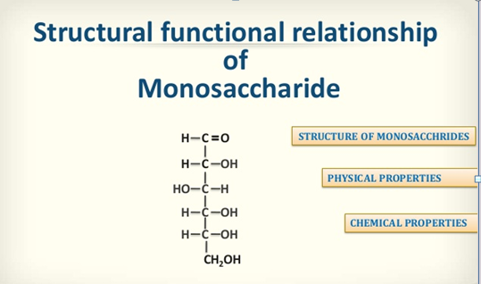

Slide 12
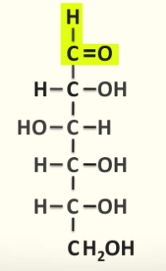
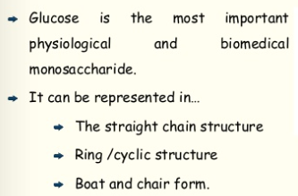
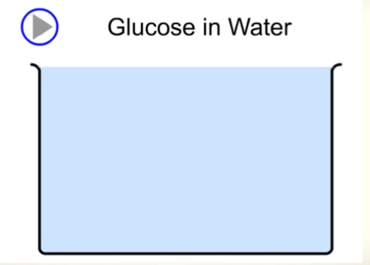
Glucose

Slide 13
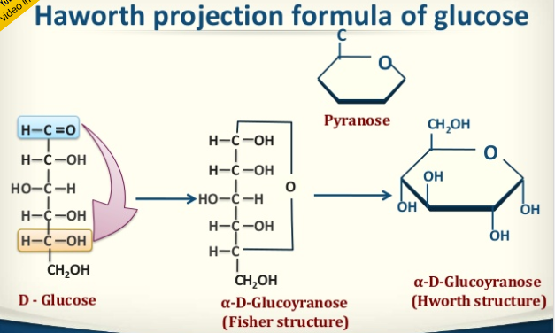
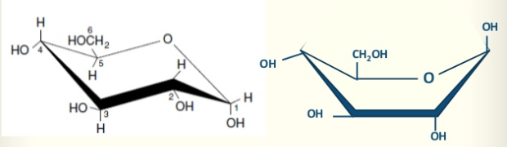
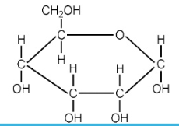

Slide 14


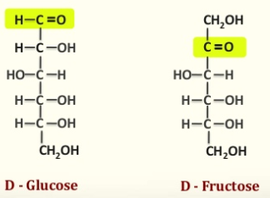

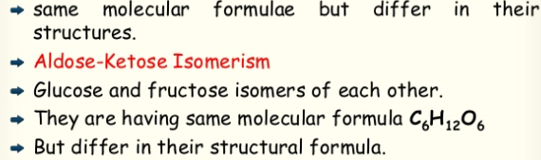

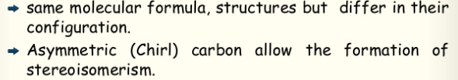

Slide 15

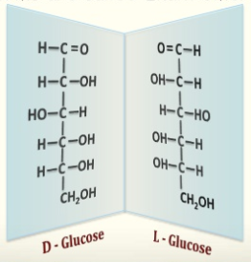

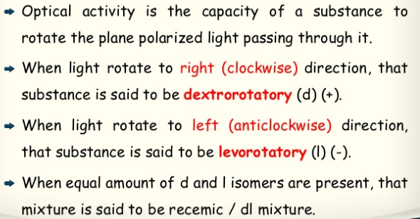

Slide 16

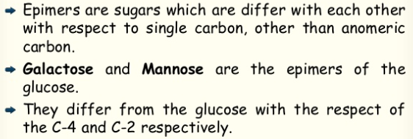
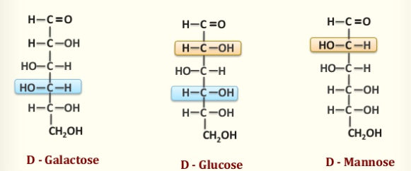

Slide 17

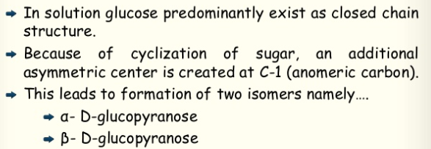
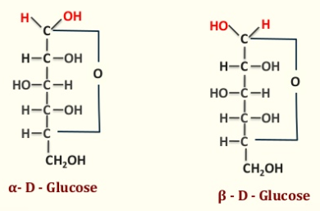

Slide 18


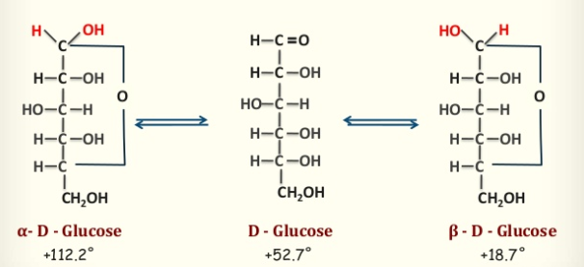

Slide 19
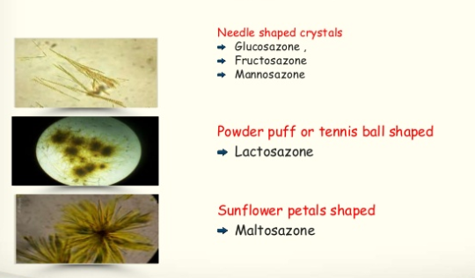

Slide 20

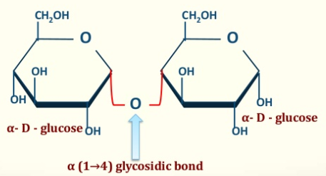
Disaccharides (two + sugars)
When two monosaccharides are combined together by glycosidic linkage, a disaccharide is formed.
Two types:-
1. Non-reducing
Sucrose- Cane sugar
Trehalose- in yeast
2. Reducing
Lactose - Milk sugar
Maltose - Malt sugar
2 glucose residues
• Reducing disaccharide
• Malt sugar
• Osazone:- Star shaped or flower petal shaped

Slide 21

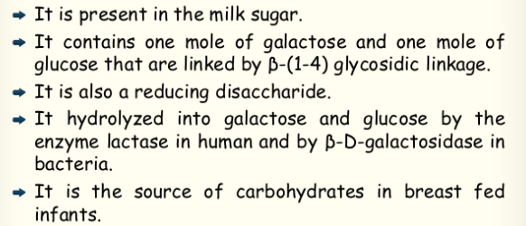
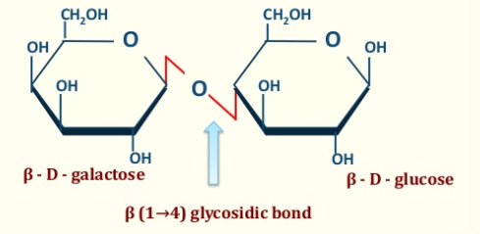
Milk sugar
• Galactose + Glucose
• Reducing disaccharide
• Beta glycosidic linkage
• Osazone – Powder Puff or hedgehog shaped

Slide 22

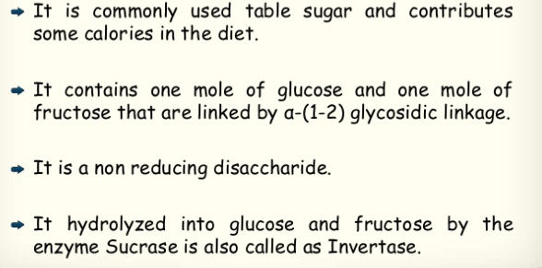
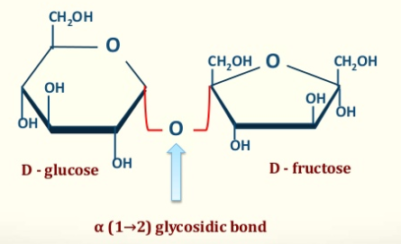
Cane sugar, table sugar
Glu + Fru
• Sweetening agent
• Non-reducing
• No osazones
• Clinical Importance:-
-dental caries
-Bypasses metabolic check points-
OBESITY- “Sucrase deficiency “

Slide 23
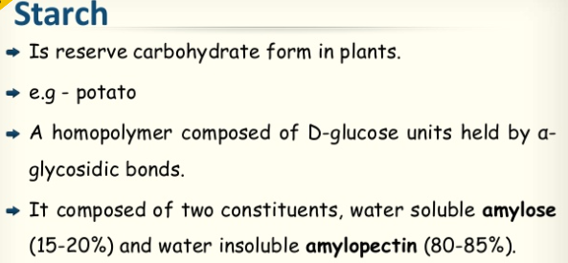
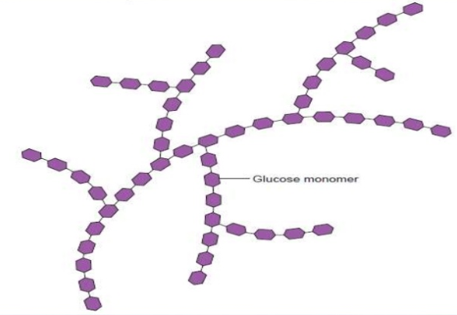
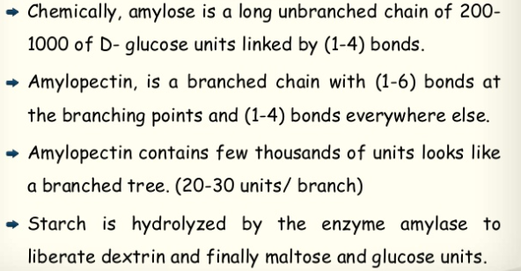
(many + sugars)

Slide 24
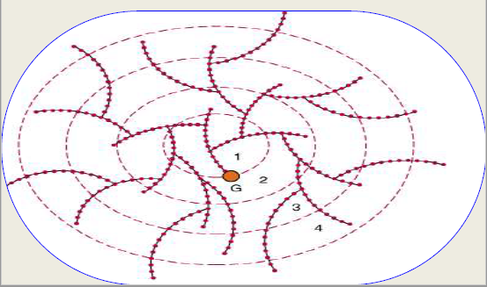
Glycogen
Storage form of energy in animal.
• Stored in liver and muscle
• Stores more glucose residues per gram than starch.
• More branched and compact than starch.
• Less osmotic pressure.
• More energy in a smaller space.
• Glycogen in liver (6-8%) is higher than that in the muscles (1-2%).
• Liver glycogen - first line of defense against declining blood glucose levels especially between meals.
A homopolysaccharide: linear chain of (1→4) linked glucosyl residues with branches joined by (1→6) linkages

Slide 25
Cellulose
Glucose units combined by -1,4 linkages.
• Straight line str. with no branches.
• Mol wt 2-5 million.
• This bond is digested by cellobiases an enzyme not present in humans.
• Herbivores animals have large caecum which harbor bacteria which break cellulose.
• White ants (termites) and some wood fungi also have cellulase.
• Commercial applications: nitrocellulose, cellulose acetate membranes for electrophoresis ETC
Inulin
D -fructose in -1,2 linkages.
• Source: Bulbs and tubers chicory, dahlia, dandelion, onions, garlic.
• Not metabolized .
• Not absorbed nor secreted by kidneys.
• USE – to measure GFR.

Slide 26
Reference:
• Test Book of Biochemistry- Harper
• Test Book of Biochemistry - Dr. U.Satyanarayana
• Test Book of Medical Biochemistry-DM.Vasudevan
• Test Book of Medical Biochemistry – MN Chatterjea

