Slide 1
ICH
INTERNATIONAL CONFERENCE FOR HORMONIZATION
Presented By
K. Gayathri Devi, M. Pharm.,
Assistant Professor,
Department Of Pharmaceutical Analysis,
MAM College Of Pharmacy,
Kesanupalli.

Slide 2
CONTENTS
INTRODUCTION
NEED FOR HARMONISE
ORIGIN OF ICH
EVOLUTION OF ICH
OBJECTIVES OF ICH
ICH MEMBERS
PROCESS OF ICH
ICH GUIDELINES Q,S,E,M

Slide 3
INTRODUCTION
ICH stands for “International Conference on Harmonization of Technical Requirements for Registration of Pharmaceuticals for Human Use”.
Which is international non-profit Association ,which is unique in bringing together the regulatory authorities and pharmaceutical industries.
Where European Union, Japan and the USA involve in scientific and technical discussions of the testing procedures required to assess and ensure the safety, quality and efficacy of medicines.
These are the three pillars on which the health of the patients depend.
ICH Guidelines accepted as law in several Countries to ensure and access the Q,S,E of medicines but are only used as guidance for the U.S Food and Drug Administration.
Each regulatory co-sponsor implements the guidelines according to its National or Regional requirements.
They are intended to be used in combination with any regional requirements.

Slide 4
Need to Harmonize
Many time-consuming and expensive test procedures, in order to market new products, internationally.
Over rising costs of health care making safe and efficacious new treatments available to patients in need.
Divergence in technical requirements from country to country.

Slide 5
ORIGIN OF ICH
Harmonization of regulatory requirements was pioneered by the EU, Europe, in the 1980s as the Europe move towards the development of single market.
The success achieved in Europe demonstrated that harmonization was feasible.
At the same time there were discussions between Europe, Japan and the US on possibilities for harmonization.
The birth of ICH took place at a meeting in April 1990.
Topics selected for harmonization would be divided into safety ,quality and efficacy to reflect the three criteria which are the basis for approving and authorizing new medicinal products.

Slide 6
EVOLUTION OF ICH
First decade : significant progress in the development of ICH Guidelines on Safety ,Quality and Efficacy topics and also work on a number of important multidisciplinary topics.
Second decade: implementation of ICH Guidelines in the ICH regions. Expand communication and information on ICH Guidelines with other regions.
Third decade : extending the benefits of harmonization beyond the ICH regions. Training ,as well as active participation of other regions in Guideline development is seen as key in this effort.

Slide 7
OBJECTIVES OF ICH
Promote public health by early availability of drug in the market.
Maintaining safeguards on quality, safety and efficacy.
Improve efficiency of new drug development ,Reduce registration cost.
Less expensive drugs for patients.
Prevent the duplication of clinical trails in humans.
Minimize the animal use with out compromising in safety ,efficacy of the product.
Mutual acceptance of clinical data by regulatory authority.
Reducing testing duplication.

Slide 8
ICH MEMBERS
EU
EFPIA (European federation of pharmaceutical industries’ associations).
MHLW (Ministry of health, Labour and welfare, Japan).
JPMA (Japan Pharmaceuticals manufacturers Association).
US FDA.
PhRMA(pharmaceutical research and manufacturers association).
Observers : WHO, TPP(Canada).
International federation of Pharmaceutical manufacturer’s association.

Slide 9
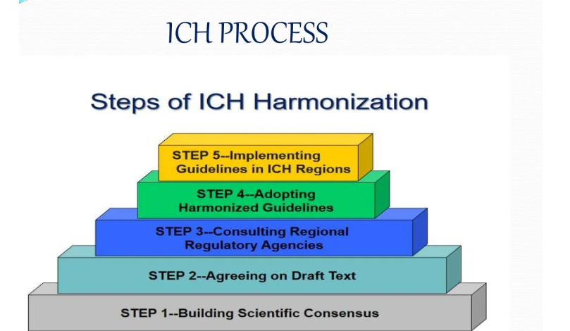

Slide 10
ICH GUIDELINES
The guidelines of ICH are broadly categorized into four types.
1) Quality guidelines.
2) Safety guidelines.
3) Efficacy guidelines.
4) Multidisciplinary guidelines.

Slide 11
QUALITY: Harmonization achievements in the Quality area include such as the conduct of stability studies, defining relevant thresholds for impurities testing and a more flexible approach to pharmaceutical quality based on Good Manufacturing Practice (GMP) risk management.
SAFETY : ICH has produced a comprehensive set of safety Guidelines to potential risks like carcinogenicity, Geno toxicity and nephrotoxicity etc.,
EFFICACY : The work carried out by ICH under the Efficacy heading is concerned with the design, conduct, safety and reporting of clinical trials. It also covers novel types of medicines derived from biotechnological processes and the use of pharmacogenomics / genomics techniques to produce better targeted medicines.
MULTIDISCPLINARY : These are the cross-cutting topics which do not fit uniquely into one of the Quality, Safety and Efficacy categories. It includes the ICH medical terminology (Med DRA), the Common Technical Document (CTD) and the development of Electronic Standards for the Transfer of Regulatory Information (ESTRI).

Slide 12
QUALITY GUIDELINES
Q1A - Q1F :Stability
Q2 : Analytical Validation
Q3A - Q3D : Impurities
Q4 - Q4B : Pharmacopoeias
Q5A - Q5E : Quality of Biotechnological Products
Q6A- Q6B : Specifications
Q7 : Good Manufacturing Practice
Q8 : Pharmaceutical Development
Q9 : Quality Risk Management
Q10 : Pharmaceutical Quality System
Q11 : Development and Manufacture of Drug Substances
Q12 : Lifecycle Management
Q13 : Continuous Manufacturing of Drug Substances and Drug Products
Q14 : Analytical Procedure Development

Slide 13
SAFETY GUIDELINES
S1A - S1C : Carcinogenicity Studies
S2 : Geno toxicity Studies
S3A - S3B : Toxic kinetics and Pharmacokinetics
S4 : Toxicity Testing
S5 : Reproductive Toxicology
S6 : Biotechnological Products
S7A - S7B : Pharmacology Studies
S8 : Immune toxicology Studies
S9 : Nonclinical Evaluation for Anticancer Pharmaceuticals
S10 : Photo safety Evaluation
S11 : Nonclinical Paediatric Safety

Slide 14
EFFICACY GUIDELINES
E1 : Clinical Safety for Drugs used in Long-Term Treatment
E2A - E2F : Pharmacovigilance.
E3 : Clinical Study Reports
E4 : Dose-Response Studies
E5 : Ethnic Factors
E6 : Good Clinical Practice
E7 :Clinical Trials in Geriatric Population
E8 : General Considerations for Clinical Trials
E9 :Statistical Principles for Clinical Trials
E10 : Choice of Control Group in Clinical Trials
E11 - E11A : Clinical Trials in Paediatric Population
E12 :Clinical Evaluation by Therapeutic Category
E14 :Clinical Evaluation of QT
E15 :Definitions in Pharmacogenomics
E17 : Multi-Regional Clinical Trials
E18 : Genomic Sampling

Slide 15
MULTIDISCIPLINARY GUIDELINES
M1 : Med DRA Terminology
M2 : Electronic Standards
M3 : Nonclinical Safety Studies
M4 : Common Technical Document .
M5 : Data Elements and Standards for Drug Dictionaries
M6 : Gene Therapy
M7 : Mutagenic impurities
M8 : Electronic Common Technical Document (eCTD)
M9 : Biopharmaceutics Classification System-based Bio waivers
M10 : Bioanalytical Method Validation

