Slide 1

ANTIEPILEPTICS & CNS STIMULANTS
Mr. ALETI VAMSI
Assistant Professor
Department of Pharmaceutical Chemistry
M.A.M College of Pharmacy, Narasaraopet

Slide 2
INTRODUCTION:
DEFINITION
Epilepsy is a collective designation for a group of chronic CNS disorders having in common the occurrence of brief and self limited ,sudden, and transitory seizures of abnormal motor , sensory , autonomic or psychic origin resulting into a repeated neuronal discharge
Epilepsy is an age- long disease which often involves convulsive seizures.
- Hippocrates first coined the word EPILEPSY derived from greek word ‘EPILAMBANEIN’ which means ‘to seize’ or convulsions.

Slide 3
A convulsion is a violent involuntary spasmodic contraction of the skeletal musculature.
- The anti epileptic drugs are also termed as ANTI –CONVULSANTS and ANTI- SEIZURE DRUGS that are used invariably in the adequate and impressive control and management of CNS disorders essentially characterized by recurrent transient attacks of disturbed brain function which ultimately give rise to motor(convulsive) sensory(seizure) and psychic sequence of events.

Slide 4
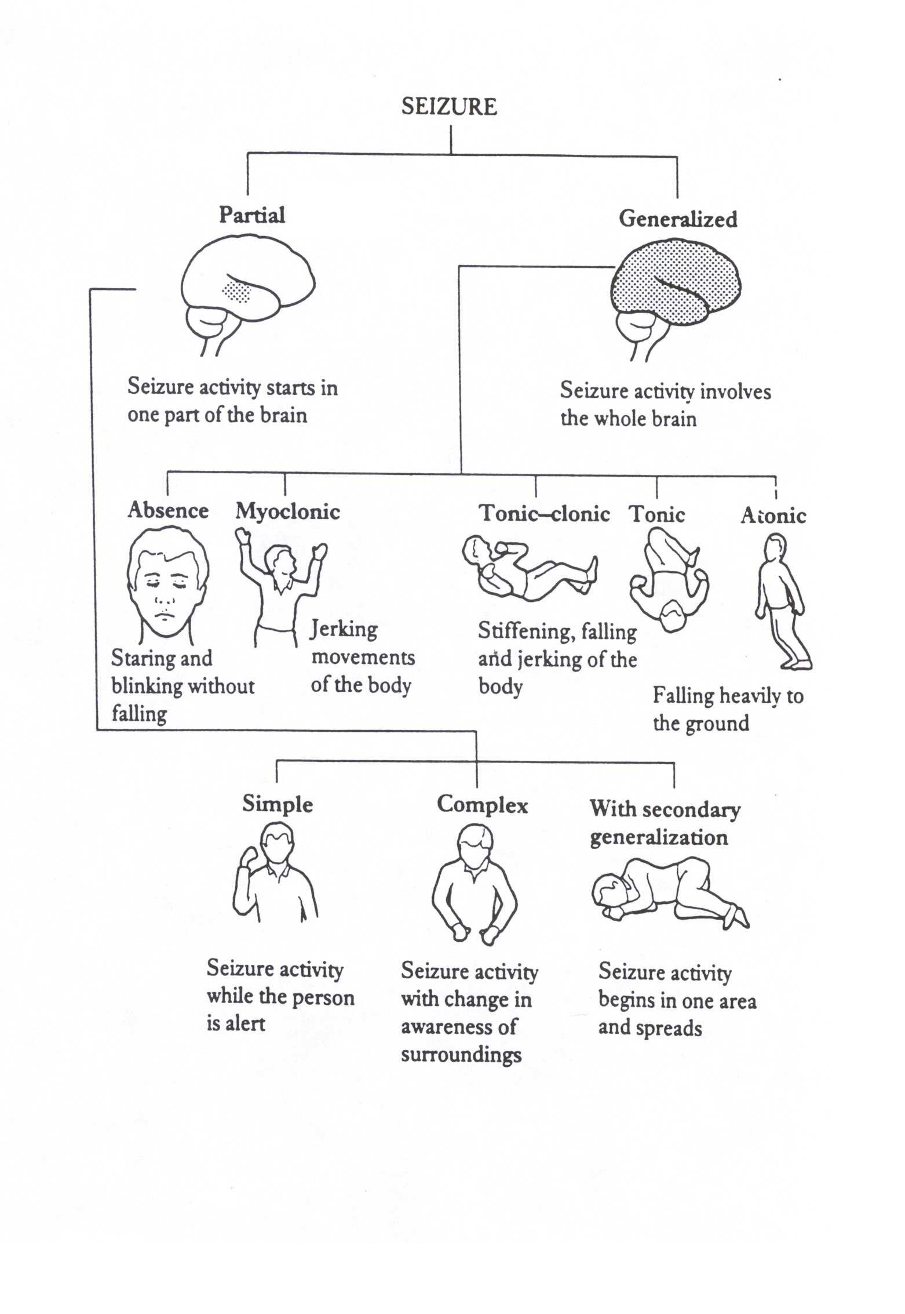
CLASSIFICATION OF EPILEPSIES
Types of
s

Slide 5
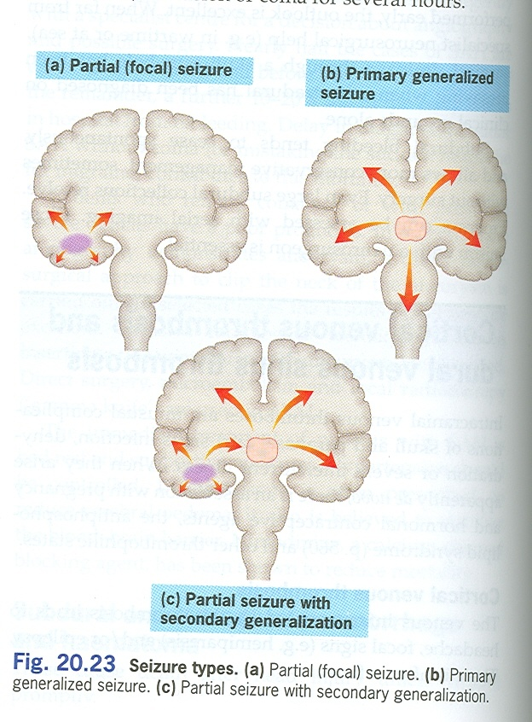

Slide 6
Types of epilepsy
There are many types of epilepsy. All types cause seizures. It can be hard to determine what type of epilepsy you have because of the numerous possible causes, because different types of seizures can occur in the same person, and because the types may affect each person differently.
Some specific types of epilepsy are:
Benign focal childhood epilepsy, which causes muscles all over the body to stiffen and jerk. These usually occur at night.
Childhood and juvenile absence epilepsy which causes staring into space, eye fluttering, and slight muscle jerks.

Slide 7
Infantile spasms (West syndrome) which causes muscle spasms that affect a child's head, torso, and limbs. Infantile spasms usually begin before the age of 6 months.
Juvenile myoclonic epilepsy which causes jerking in the shoulders or arms.
Lennox-Gastaut syndrome, which causes frequent and several different types of seizures to occur. This syndrome can lead to falls during a seizure, which can cause an injury.
Temporal lobe epilepsy (the most common type of epilepsy in adults), which causes smacking of the lips or rubbing the hands together, emotional or thought disturbances, and hallucinations of sounds, smells, or taste.
Epilepsy is not a form of intellectual disability or mental illness. Although a few forms of childhood epilepsy are linked with below-average intelligence and problems with physical and mental development, epilepsy does not cause these problems. Seizures may look scary or strange, but they do not make a person crazy, violent, or dangerous.

Slide 8
DRUGS USED IN THE TREATMENT OF CONVULSIVE DISORDERS
They are divided into:
Drugs which are used to abolish convulsions (anticonvulsants)
Drugs which are administered prophylactically to prevent convulsions.
Centrally acting - eg: General anesthetics
Paraldehyde
Barbiturates
Diazepam and
Specific antiepileptic drugs
Acting mainly on the spinal cord - eg: Mephenesin
Peripheral skeletal muscle relaxants - eg: D-tubocurarine
Succinylcholine

Slide 9
CLASSIFICATION OF ANTICONVULSANTS
The anticonvulsants are classified into
Barbiturates - Phenobarbital
Methyl phenobarbitone
Hydantoins - Phenytoin sodium
Ethotoin
Mephenytoin
Oxazolidinediones - Trimethadione
Paramethadione
Succinimides - Phensuximide
Methsuximide
Ethosuximide

Slide 10
Urea and monoacyl ureas - Phenacemide
Carbamazepine
Miscellaneous antiepileptics - clonazepam , Diazepam , Primidone , Sodium valproate
New generation of antiepileptics - Lamotrigine , Gabapentin , Vigabatrin , Denzimol , Denzinamide, fosphenytoin,Nafimidone , Ralitoline , Topiramate,Zonisamide, functionalized amino acids

Slide 11
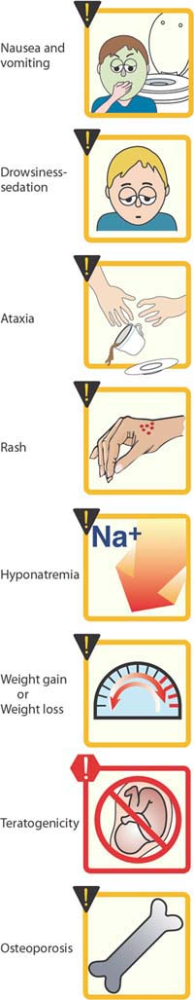
Notable adverse effects of antiseizure medications

Slide 12
Mechanisms of Action
3 main categories of therapeutics:
  Inhibition of voltage-gated Na+ channels to slow neuron firing.
  Enhancement of the inhibitory effects of the neurotransmitter GABA.
  Inhibition of calcium channels.

Slide 13
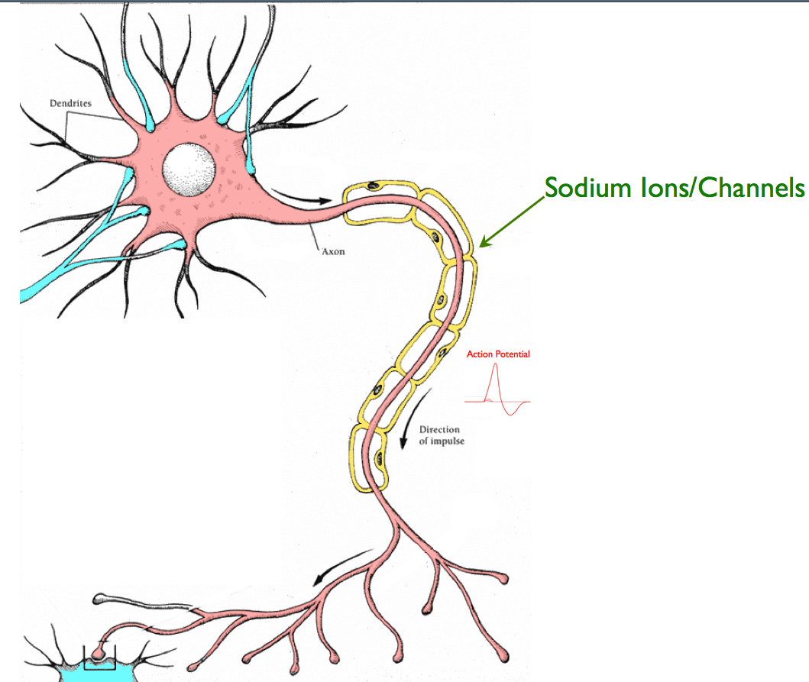
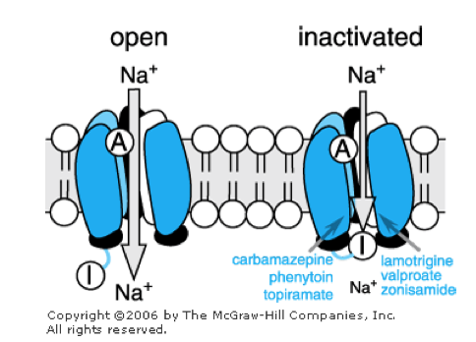
Na+ Channel Inhibitors
blocks voltage-gated sodium channels by selectively binding to the channel in the inactive state and slowing its rate of recovery

Slide 14
Phenytoin (Dilantin, Phenytek)
Fosphenytoin (Cerebyx)
Carbamzepine (Tegretol, Carbatrol)
Oxcarbazepine (Trileptal)
Valproic Acid (Valproate; Depakene, Depakote)
Lamotrigine (Lamictal)
Topiramate (Topamax)
Zonisamide (Zonegran)

Slide 15
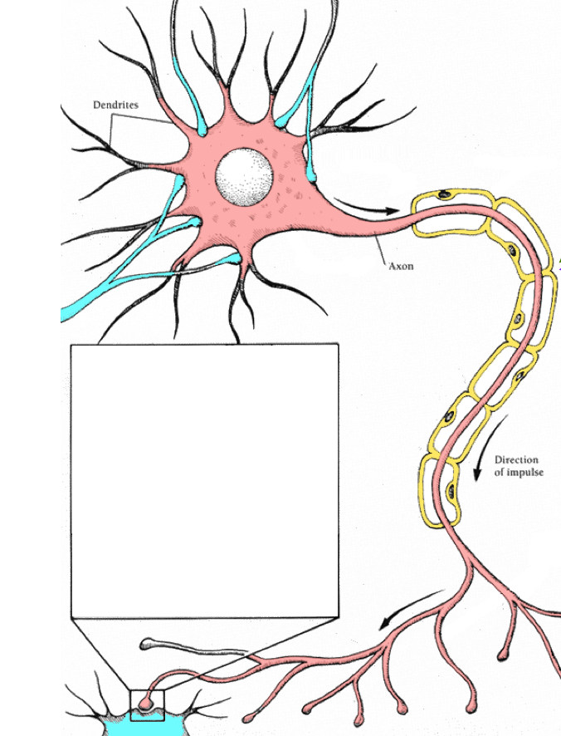
Enhancement of GABA Inhibition

Slide 16
Barbiturate drugs:
Phenobarbital (Luminal)
Primidone (Mysoline)
Benzodiazepine drugs:
  Diazepam (Valium)
  Lorazepam (Ativan)
  Clonazepam (Klonopin)
  Clorazepate (Transxene-SD)
  3.Tiagabine (Gabitril):

Slide 17
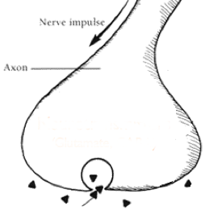
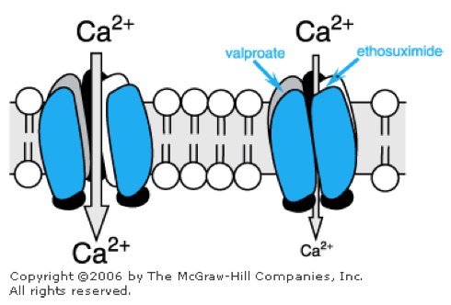
Calcium Channel Blockers
inhibit low-threshold (T-type) Ca 2+ currents, especially in thalamic neurons that act as pacemakers to generate rhythmic cortical discharge.

Slide 18
Ethosuximide (Zarontin):
Gabapentin (Neurontin):
Pregabalin (Lyrica):
Levetiracetam (Keppra):
Block the N-methyl-D-aspartate (NMDA)
glutamate receptor
Felbamate

Slide 19
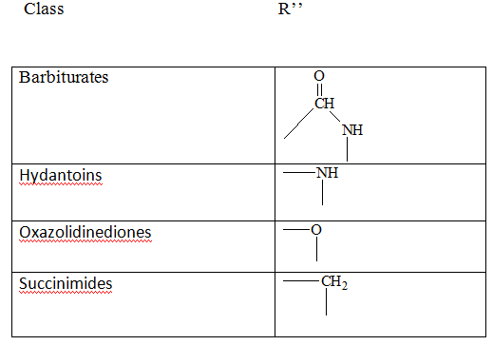
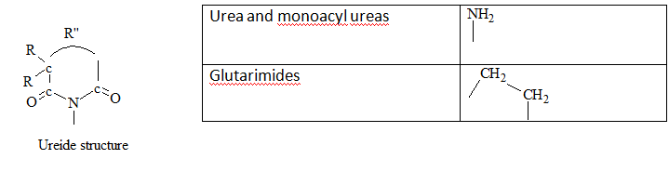
STRUCTURAL FEATURES COMMON TO DRUGS

Slide 20
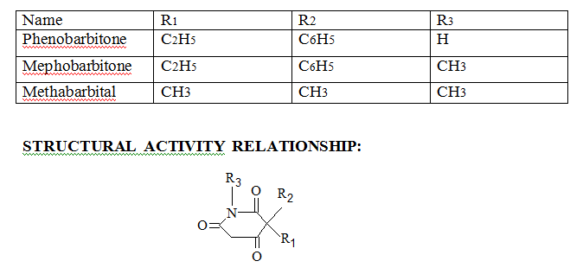
1.BARBITURATES:

Slide 21
- Optimum activity is obtained when one substituent at C5 is phenyl
- The 5,5 – diphenyl derivatives has less activity than phenobarbitone.
- N1 and N3 substitution in some case also resulted in increased activity.
- 5,5 –dibenzyl barbituric acid causes convulsion.
MECHANISM OF ACTION:
The potentiation of GABA inhibition in the CNS . Barbiturates also antagonise glutamate excitation.
USES:
- Phenobarbital is orally administered in the treatment of grand mal epilepsy
- It is less effective in the treatment of petit mal and psychomotor epilepsies . The injectables form of the drug is used to treat other types of convulsions.

Slide 22
TOXICITY:
- Sedation and drowsiness are the most common effects with the beginning of therapy while tolerance develops during chronic treatment .
- Irritation and hyperactivity in children and confusion in older aged people are observed with phenobarbitone.
Folate deficiency , hypocalcaemia and coagulation defects in the new-bron aare other toxic reactions.
2. HYDANTOINS:
The hydantoins are close structural relatives of barbituric acid , differing in lacking of 6-oxo groups. The lack of this carbonyl group decreases the acidity , so it is weaker acid than that of barbiturates.

Slide 23
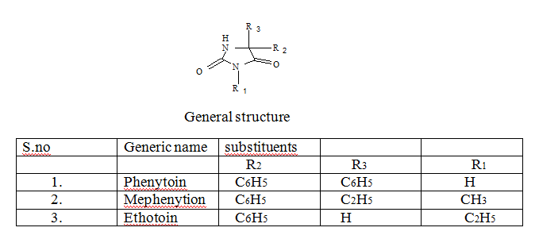

Slide 24
STRUCTURAL ACTIVITY RELATIONSHIP:
1. A 5-phenyl or other aromatic substituent is essential for the activity.
2. Alkyl substituents at position 5 may contribute to sedation a properly absent in phenytoin.
3. Among other Hydantoins , like spiro-hydantoin ,thiohydantoins , dithiohydantoins and 1,3- disubstituted hydantoins , some exhibit activity against chemically induced convulsions while remaining are ineffective against electroshock induced convulsions.

Slide 25
MECHANISM OF ACTION:
It is anticonvulsant drug acting on Na+ channels blocker. It has been observed that both Na+ and Cl- ions are invariably present at much higher concentration outside the cells, whereas K+ charged proteins and organic cations are more abundantly available inside the cell. Epileptic seizure cause Na+ ion accumulation within the central neuron , which initiates enhanced synaptic nerve transmissions following pre synaptic stimulation. Phenytoin decreases Na+ intracellular ion by activating biochemical process that normally extrudes Na+ ion from neurons.

Slide 26
USES:
- Phenytoin is used alone or in combination with Phenobarbital in the treatment of Grand Mal and Psychomotor Epilepsy.
- It is also used in the treatment of other types of convulsions
- Mephenytoin is used to control seizure in combination with Phenytoin.
TOXICITY:
-Ataxia , Nystagmus , slurred speech with phenytoin

Slide 27
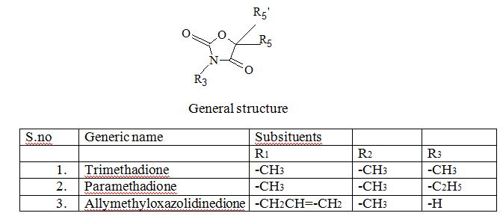
3.OXAZOLIDINEDIONES:
Replacement of the NH group at position one of the hydantoin systems with ‘O’ atom yields the oxazolidine-2,4-dione system. These compounds are iso stearically related to the hydantoin.
-Trimethadione,Paramethadione,and Allylmethyloxazolidinedione are the clinically used drugs.

Slide 28
STRUCTURAL ACTIVITY RELATIONSHIP:
1. The nature of the substituents on C5 is important .
Eg., lower alkyl substituents tend towards anti petit Mal activity while aryl substituents towards anti Grand Mal activity.
Eg : Malidione , Dimidone .
2. The N-alkyl substituents does not effect the activity since all clinically used agents from this class , undergo N-dealkylation in metabolism.
Eg: - The anticonvulsant activity of Trimethadione is due to mainly its N-demethylated metabolite ,dimethadione.
- similarly paramethadione also undergoes N- demethylation in –vivo to yield 5-ethyl-5-methyl oxazolidine-2,4-dione ,which is responsible for observed anti-convulsant action of Paramethadione.

Slide 29
MECHANISM OF ACTION:
Oxazolidinediones are effective only against Petit Mal condition . This effectiveness is due to two fold action of these agents.
1. They increase the threshold for production of Petit Mal seizures of the thalamic centres and thus prevent the spread of electrical activity of the thalamus.
2. They decrease synaptic transmission by increasing the duration of the refactory period in the neurons through which respective discharge occur.
3. Aslight inhibitoy action on the resting respiration of the brain cells is an additional effect.
USES:
-Trimethadione is used in the treatment of Petit mal Epilepsy. Dermatological and Hematological toxicities limit its clinical use.
-Paramethadione is used in the treatment of Petit Mal Epilepsy.

Slide 30
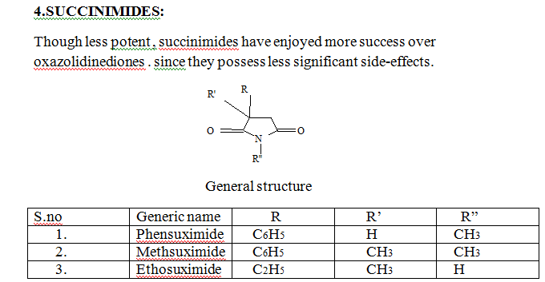

Slide 31
STRUCTURAL ACTIVITY RELATIONSHIP:
Methsuximide and Phensuximide have phenyl substituents which make them active against electrically induced convulsion.
N- methylation decreases activity against electroshock seizures and impart more activity against chemically induced convulsions.
- α- methylalkoxy phenyl succinimides and alkoxy benzyl succinimides were active anti-convulsants. The length of the alkoxy group here determine the activity.

Slide 32
MECHANISM OF ACTION:
Phensuximide is an anticonvulsant in the succinimide class. It suppresses the paroxysmal three cycle per second spike and wave EEG pattern associated with lapses of consciousness in petit mal seizures. The frequency of attacks is reduced by depression of nerve transmission in the motor cortex.
USES:
-Phensuximide is a succinimide antiepileptic agent used to treat convulsions but it is reported to be less effective.
- Ethosuximide is the drug of first choice for the treatment of Petit Mal epilepsy.
- To treat other types of epilepsy it may be used with other antiepileptic drugs.

Slide 33
TOXICITY:
- Gastrointestinal complaints like nausea , vomiting amd anorexia.
- CNS effects include drowsiness , euphoria , lethargy and headache .
- Restlessness , agitation , anxiety and skin reactions

Slide 34
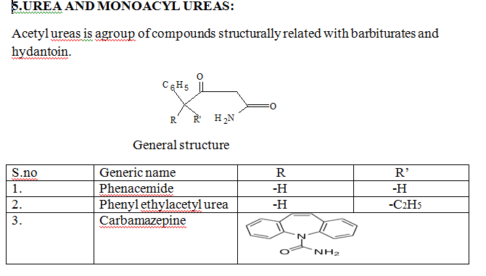

Slide 35
STRUCTURAL ACTIVITY RELATIONSHIP:
1.Among aliphatic acetylureas , the highest anticonvulsant activity is found in those derived from branched chain acids of about seven carbon atoms.
2.With a further increase in molecular weight , the anti convulsant activity gradually terminates and hypnotic effect predominates.
3.Phenacemide is most active agent amongst the aromatic acetyl urea.
4. Any substitution on the nitrogen of phenacemide does not increase further the anti convulsant activity.
5. Activity decreases with aromatic substitution of phenacemide with a gradual increase in hhypnotic activity
6. Diphenylacetyl urea is inactive.

Slide 36
MECHANISM OF ACTION:
The acetylureas inhibit the metabolism of other antiepileptic drugs and hence effective when given in combination with other antiepileptic drugs.
USES:
- Phenacemide is used as an anticonvulsant drug.
- Carbamazepine is an antiepileptic drug used to control Grand Mal and Focal seizures. It is also used in the treatment of trigeminal neuralgia and the treatment of manic depression.
TOXICITY:
Common adverse effects may include drowsiness, headaches and migraines, motor coordination impairment, and/or upset stomach. Carbamazepine preparations typically greatly decrease a person's alcohol tolerance.

Slide 37
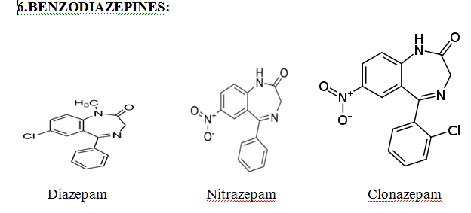

Slide 38
STRUCTURAL ACTIVTIY RELATIONSHIP:
1.The electron withdrawing atom or group at position 7 increases the anti-epileptic activity while electron donating substituents at 7, 8, or 9 positions decrease it.
2.A phenyl group at position 5 is necessary for activity . but only halogen substituents are allowed in ortho positions .
3.The electron withdrawing groups at ortho or di ortho positions at 5-phenyl increase the activity while any substituent on meta or para position at 5- phenyl decrease the activity.
4.Methyl substitution at position 1 confirms high activity

Slide 39
MECHANISM OF ACTION:
Benzodiazepines some how increase the effectiveness of GABA , an inhibitory neurotransmitter by,
Making easy the functioning of variety of GABA mediated synaptic systems.
2. Increaasing the affinity of GABA for receptor sites in brain membranes

Slide 40
USES:
1. Diazepam is mainly used to treat anxiety, insomnia, and symptoms of acute alcohol withdrawal. It is also used as a premedication for inducing sedation, anxiolysis or amnesia before certain medical procedures
2. It is approved for treatment of typical and atypical absences, infantile myoclonic, myoclonic and akinetic seizures and also as a second-line agent
3. Clonazepam is also used for the treatment of panic disorder.
TOXICITY:
-Drowsiness and fatigue are among the most common symptoms.
-Muscular inco-ordination , behavioural disturbances and increased salivary and bronchial secretions constitute less frequent side effects.

Slide 41
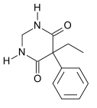
MISCELLANEOUS ANTI EPILEPTIC AGENTS:
PRIMIDONE:
It is a potent anti convulsant used in conjugation with other anti epileptic for the treatment and arrest of psychomotor.

Slide 42
USES:
- Primidone, along with phenobarbital, was a second-line agent in partial epilepsy with or without secondarily generalized tonic-clonic seizures . that was used along with ethosuximide or a benzodiazepine for any absence or myoclonic seizures when valproate failed to control tonic-clonics.
TOXICITY:
- Primidone can cause drowsiness, listlessness , ataxia, visual disturbances, nystagmus, headache, and dizziness. These side effects are the most common, occurring in more than 1% of users.
- Transient nausea and vomiting are also common side effects.

Slide 43

SODIUM VALPROATE:
MECHANISM OF ACTION:
Sodium valproate is a weak blocker of sodium ion channels; it is also a weak inhibitor of enzymes that deactivate GABA such as GABA transaminase. It may also stimulate the synthesis of GABA, but the direct mechanism is not known. Because of its many mechanisms of action, sodium valproate has efficacy in all partial and generalised seizures including absence seizures.

Slide 44
USES:
1.The sodium salt of valproicacid and is an anticonvulsantused in the treatment of epilepsy,anorexia nervosa, panicattack, anxiety disorder,posttraumaticstressdisorder, migraine and bipolar disorder, as well as other psychiatric conditions requiring the administration of a mood stabilizer.
2. Sodium valproate can be used to control acute episodes of mania and acute stress reaction.
TOXICITY
- Side effects can include tiredness, tremors, nausea, vomiting and sedation.
- GIT disturbance are most commonly observed.

Slide 45
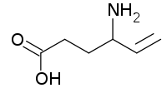
NEW GENERATION OF ANTI EPILEPTICS:
1.VIGABATRIN:
MECHANISM OF ACTION:
Vigabatrin is an irreversible suicide inhibitor of gamma-aminobutyric acid transaminase (GABA-T), the enzyme responsible for the catabolism of GABA, which increases the level of GABA in the brain. Vigabatrin is a racemic compound, and its [S]-enantiomer is pharmacologically active.

Slide 46
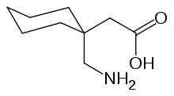
2.GABAPENTIN:

Slide 47
MECHANISM OF ACTION:
Gabapentin interacts with voltage-sensitive calcium channels in cortical neurons. Gabapentin increases the synaptic concentration of GABA, enhances GABA responses at non-synaptic sites in neuronal tissues, and reduces the release of mono-amine neurotransmitters. One of the mechanisms implicated in this effect of gabapentin is the reduction of the axon excitability measured as an amplitude change of the presynaptic fibre volley (FV) in the CA1 area of the hippocampus. This is mediated through its binding to presynaptic NMDA receptors. Other studies have shown that the antihyperalgesic and antiallodynic effects of gabapentin are mediated by the descending noradrenergic system, resulting in the activation of spinal alpha2-adrenergic receptors. Gabapentin has also been shown to bind and activate the adenosine A1 receptor .

Slide 48
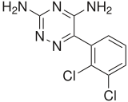
3.LAMOTRIGINE:
Lamotrigine is an anticonvulsant drug used in the treatment ofepilepsy and bipolar disorder. It is also used off-label as an adjunct in treating clinical depression .For epilepsy, it is used to treat focal seizures, primary and secondary tonic-clonic seizures, and seizures associated with Lennox-Gastaut syndrome. Like many other anticonvulsant medications, Lamotrigine also seems to act as an effective mood stabilizer.

Slide 49
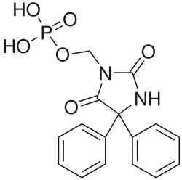
4.FOSPHENYTOIN:
Fosphenytoin is a water-solublephenytoin prodrug that is administered intravenously to deliver phenytoin, potentially more safely than intravenous phenytoin. It is most commonly used in the acute treatment convulsive status epilepticus.

Slide 50
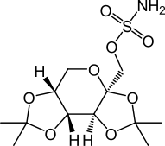
5.TOPIRAMATE
Topiramate (brand name Topamax) is an anticonvulsant (antiepilepsy) drug. In late 2012, topiramate was approved by the United States Food & Drug Administration (FDA) in combination with Phentermine for weight loss
USES:
1.Topiramate is used to treat epilepsy in children and adults, and it was originally used as an anticonvulsant. In children, it is indicated for the treatment of Lennox-Gastaut syndrome, a disorder that causes seizures and developmental delay.
2. This drug is also widely used to treat migraines due to the effect it has on the blood vessels in the brain. It is used as a preventative for atypical migraine sufferers.

Slide 51
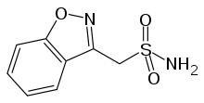
6.ZONISAMIDE
Zonisamide is a sulfonamide anticonvulsant approved for use as an adjunctive therapy in adults with partial-onset seizures; infantile spasm, mixed seizure types of Lennox-Gastaut syndrome, myoclonic, and generalized tonic clonic seizure

Slide 52
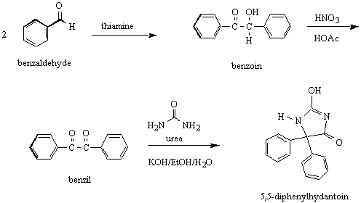
SYNTHESIS OF DIPHENYL HYDANTOIN

Slide 53
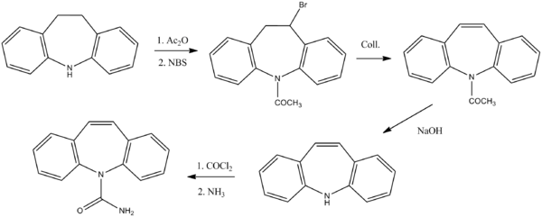
SYNTHESIS OF CARBAMAZEPINE:

Slide 54
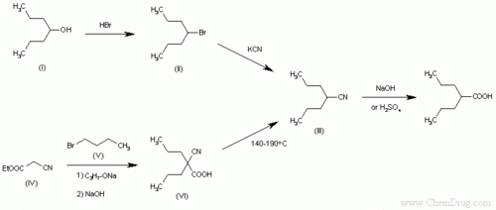
SYNTHESIS OF SODIUM VALPROATE:

Slide 55
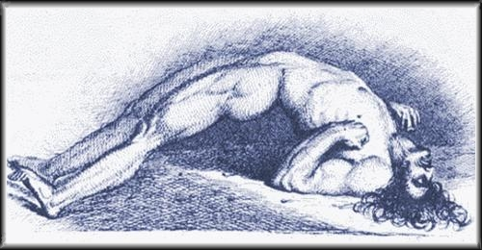
CENTRAL NERVOUS SYSTEM STIMULANTS

Slide 56
Drugs that have a predominant stimulant effect on the CNS fall into the following broad categories:
a. Respiratory stimulants or Analeptics
b. Psychomotor stimulants.
c. Antidepressants.
d. Psycho mimetic drugs or Hallucinogenic drugs.

Slide 57
- Drugs that have stimulant effect on CNS fall into the categories:
a) Convulsant respiratory stimulant (Analeptics): They have effect on mental function and appears to act mainly on the brain stem and spinal cord producing reflex excitability , as increases in activity of the respiratory and vasomotor centre with higher doses convulsions.
b) Psychomotor stimulants: (Amphetamine , Caffeine , Cocaine) have a marked effect on mental function and behavior , producing excitement , sensation of fatigue and increase in motor activity.

Slide 58
c) Antidepressants drugs: It is used in depressive disorders. These are mood elevating and antiagitatonal.
d) Psycho mimetic drugs: Mainly effect thought pattern , perception and mood producing effects that super facial resemble the changes seen in schizophrenia

Slide 59
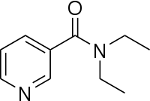
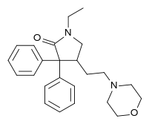
1. ANALEPTICS
Eg : Nikethamide , Doxapram
USES
Doxapram administered as a continuous infusion (2 to 3 mg/minute) has been used as a temporary measure to maintain ventilation during administration of supplemental oxygen to patients with chronic obstructive airway disease who otherwise depend on a hypoxic drive to maintain adequate minute ventilation Administered concomitantly with intramuscular meperidine, doxapram prevents the ventilatory depression produced by the opioid without altering analgesia, suggesting a possible benefit in the early postoperative period ..

Slide 60
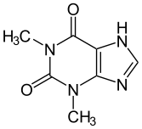
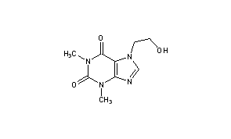
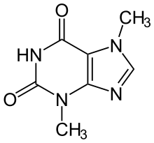
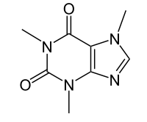
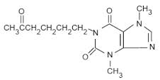
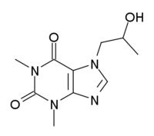
2.XANTHINE DERIVATIVES:
Theobromine
Etofylline
Theophilline
caffeine
Proxyphylline
Pentoxyphylline

Slide 61
USES:
- Methylxanthines are used as analeptics to treat primary apnea of prematurity .
- The slowed metabolism of methylxanthines in neonates compared to adults is a consideration when using theophylline to stimulate ventilation in neonates.
- Selective beta₂-adrenergic agonists delivered by inhalation have largely replaced theophylline preparations in the treatment of bronchospasm associated with asthma.
- Recognition of theophylline’s antiinflammatory effects could be useful for chronic management of asthma, although the narrow therapeutic index and significant side effects are likely to limit its use.

Slide 62
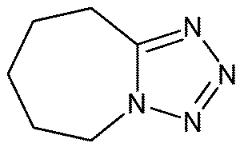
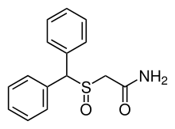
3.PSYCHOMOTOR STIMULANTS:
Pentetrazole
Modafinil

Slide 63
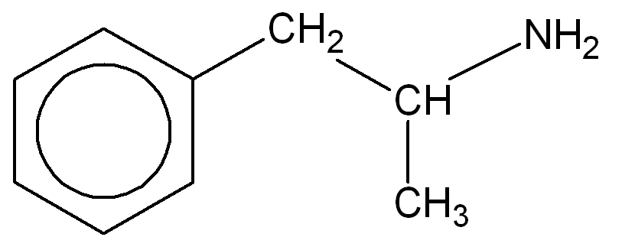
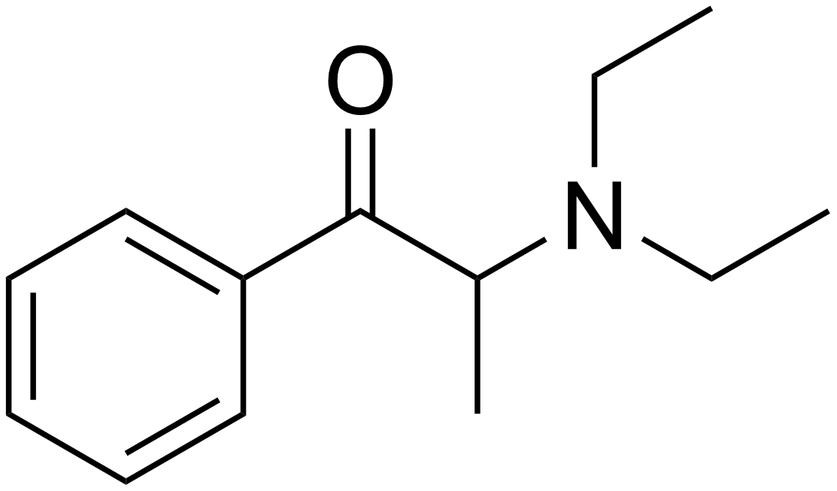
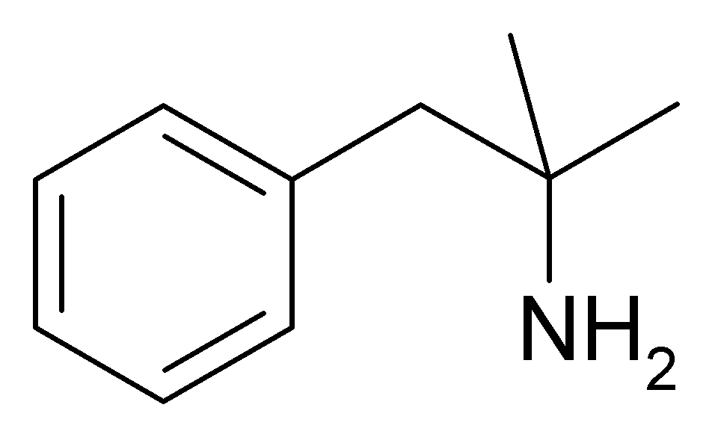
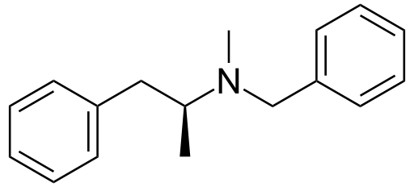
4.CENTRAL SYMPATHOMIMETIC ANALEPTICS:
USES:
- Methamphetamine is a sympathomimetic drug used as CNSstimulant.
- Benzphetamine reduce appetite with less CNS excitatory effect.
- Diethyl propion is less active than amphetamine. It is used for the treatment of obesity in patient with hypertension and cardiovascular disease.
Dietyhlpropion
Amphetamine
phenteramine
Benzphetamine

Slide 64
5.ANTIDEPRESSANTS :
CLASSIFICATION :
1.Mono amine oxidase inhibitors – eg: Phenelzine , Tranyl cypromine
2.Tricyclic antidepressants :
a) Imino dibenzyl derivatives - eg: Imipramine , Desipramine
b) Dibenzocycloheptene derivatives – eg: Amitriptylline, Protriptylline
c) Dibenzoxepine derivatives – eg: Doxepin
3.Selective Serotinin reuptake inhibitors(SSRI) –eg: Citalopram , escitalopram , fluoxetine , sertraline.
4.Selective norepinephrine reuptake inhibitors – eg; Venlafexine , Roboxetine
5. Miscellaneous antidepressants or heterocyclics – eg: Bupropion , Trazadone .

Slide 65
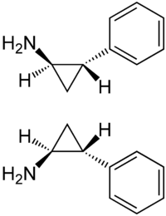

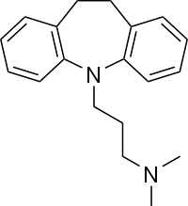
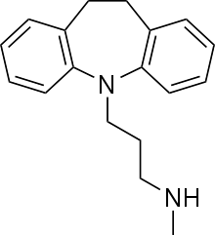
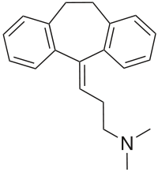
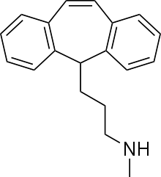
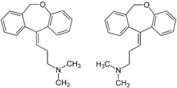
STRUCTURES OF ANTI DEPRESSANT DRUGS
Phenelzine
Tranyl cypromine
Imipramine
Amitriptylline
Desipramine
Protriptylline
Doxepin

Slide 66
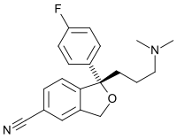
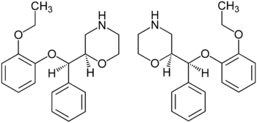
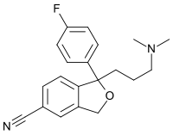



Citalopram
Escitalopram
Roboxetin
Venlafexine
Bupropion
Mirtazapine

Slide 67
6.PSYCHO MIMETIC DRUGS ( HALLUCINOGENIC DRUG)
CLASSIFICATION:
1.Aryl amino hallucinogens
a) Indolethylamines – eg : Psilocybin and psilocin
b) 2- Phenylethylamine – eg: Mescaline
c) Agents possessing both Indoethylamine and phenylethylamine moiety -eg: lysergic acid diethylamine
2.Dissociate agent – eg: Phencyclidine
3.Euphoriant stimulant – eg: Cocaine
4.Depressant intoxicant – eg:

Slide 68




STRUCUTES OF DRUGS:
lysergic acid diethylamine
Phencyclidine

Slide 69



Slide 70
CLINICAL USES :
To counteract lethargy and fatigue throughout the day while at work or while doing other activities.
To reduce sleepiness and to keep the person awake when necessary, as well as to treat narcolepsy.
To decrease appetite and promote weight loss, as well as to treat obesity.
To improve concentration and focus while at work or school, especially for those with attentional disorders such as ADHD.
Occasionally, they are also used off label to treat clinical depression, more particularly, non-typical depression and treatment-resistant depression.

Slide 71
REFERENCES:
K. Illango , P.Valentina - Text book of medicinal chemistry Keerthi publishers in 2007 , Chennai - vol – 1 page no:174-189
Dr. S. S. Kadam , Dr. K . R .Mahadik , Dr K .G Bothara - Text book of Principles of Medicinal chemistry , Nirali prakashan in 2010 , revised edition - vol-2 page no 8.20-8.41
Wilson and Gisvold’s – Text book of organic medicinal and pharmaceutical chemistry , published by Wolters kluwer (India) pvt.ltd - New Delhi , 12th edition , page no : 491- 501.
Nadendla Rama rao - Principles of Organic Medicinal chemistry , new age international pvt. Ltd publishers in 2005 , New Delhi
page no 102-120.

Slide 72
http://en.wikipedia.org/wiki/Stimulant .
http://en.wikibooks.org/wiki/pharmocology/Antiepileptics .
http://en.wikipedea.org/wiki/anticonvulsant.
http://www.healthline .com/alecontent/central-nervous-system stimulants
http://www.icm.tn.gov.in/drug%20formulary/ANTIEPILEPTIC%20DRUS.htm

Slide 73

Thank you

