Slide 1
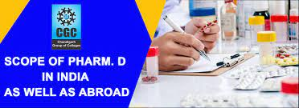
PHARM.D JOB OPPORTUNITIES IN ALL SECTORS IN INDIA AND COMPETITIVE EXAMINATIONS AFTER PHARM.D COURSE
RESOURCE PERSON :
DR.Y.NARASIMHA RAO,M.Pharm.,Ph.D
Professor and HOD
Dept.of pharmacology

Slide 2
PHARM.D JOB OPPORTUNITIES IN ALL SECTORS IN INDIA
HEALTH CARE SECTOR
PHARMACEUTICAL INDUSTRIES
CLINICAL RESEARCH ORGANIZATIONS
PUBLIC HEALTH SECTOR
RESEARCH AND DEVELOPMENT
INSURANCE COMPANIES
ACADEMICS

Slide 3

HEALTH CARE SECTOR
Clinical pharmacist
Clinical manager
Head of the pharmacist
Drug information pharmacist
Research associate
Hospital administrator

Slide 4
RESEPONSBILITIES OF CLINICAL PHARMACIST
Develop clinical pharmacy programs according to policies and regulations.
Review records of patients to determine the appropriateness of medication therapy.
Evaluate patient's condition to ensure all issues are being treated.
Identify untreated health problems and refer patients to appropriate physicians
Develop effective medication plans that minimize the risk of adverse side-effects
Consult on dosages, medication substances etc.
Advise on the correct administration of drugs

Slide 5
RESEPONSBILITIES OF CLINICAL MANAGER
A clinical manager maintains responsibility for all administrative aspects of a clinical facility. Daily, you might be responsible for on boarding new employees, training existing employees, auditing clinic operations, establishing a budget, reviewing treatment plans, or communicating with executives

Slide 6
RESEPONSBILITIES OF HEAD OF THE PHARMACIST
Pharmacy managers are responsible for overseeing the daily business operations of a pharmacy, including dispensing prescription medication and advising clients.
Other duties entail managing the pharmacy staff and the inventory, and ensuring the safe storage of prescription drugs and controlled substances.

Slide 7
RESEPONSBILITIES OF DRUG INFORMATION PHARMACIST
To provide an organized database of specialized information on medicines and therapeutics to meet the drug information needs of practitioners.
To educate pharmacy students to serve as effective providers of medicines information

Slide 8
RESEPONSBILITIES OF RESEARCH ASSOCIATE
The primary duties of Research Associates are to plan and conduct research. Depending on the field, this can include things like managing data, conducting interviews and publishing research

Slide 9
RESEPONSBILITIES OF HOSPITAL ADMINISTRATOR
Hospital administrators are responsible for organizing and overseeing the health services and daily activities of a hospital or healthcare facility.
They manage staff and budgets, communicate between departments, and ensure adequate patient care amongst other duties. Completely free trial, no card required

Slide 10
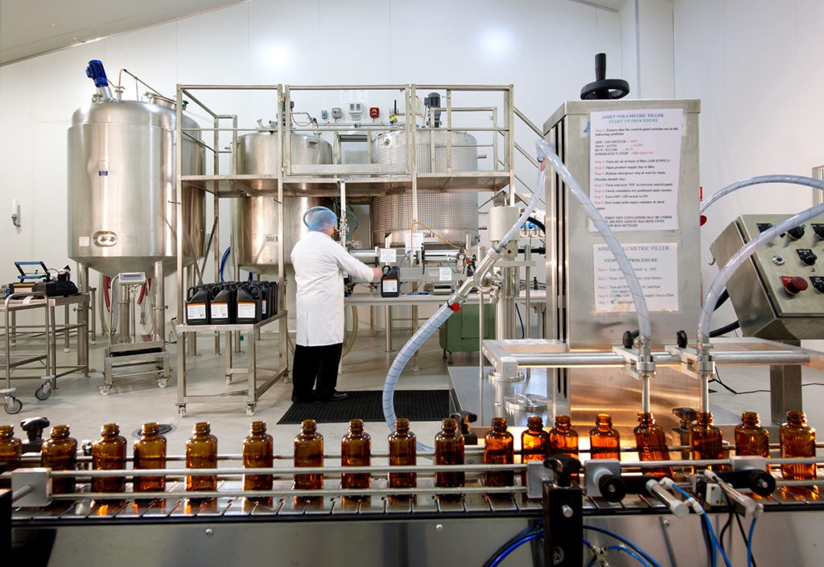
PHARMACEUTICAL INDUSTRIES
New drug development
Medical information
Medical adviser
Medical writer
Medical publications
Pharmacovigilence
Clinical operations development
Clinical data management
Drug regulation officer
Medical marketing research

Slide 11
NEW DRUG DEVELOPMENT
Pharmaceutical scientists usually specialize in one aspect of the drug development process. They may: Design new drug therapies using natural or synthetic (man-made) ingredients. Uncover new ways to use existing drugs to treat different types of disease

Slide 12
MEDICAL INFORMATION
They are responsible for compiling all of the data related to patients, their medical history, medical reports, examinations, doctor's observations, symptoms, diagnosis, treatments and prescriptions etc. A Healthcare Information Manager plays a vital role in maintaining the digital records of medical establishments

Slide 13
MEDICAL ADVISER
A Medical Advisor provides significant contribution towards the evaluation, critiquing and communication of important medical / scientific information related to a company's products. Medical Advisors assist clinical research teams and often help training and supporting the sales force.

Slide 14
MEDICAL WRITER
Medical writers work alongside scientists, doctors and other healthcare professionals to produce physical and online medical documents for educational, promotional or informative purposes

Slide 15
MEDICAL PUBLICATIONS
As the principal source of medical publications, the purpose of medical journals is to educate and inform a wide variety of healthcare professionals who must routinely and efficiently identify and deliver the most effective treatment for their patients

Slide 16
PHARMACOVIGILENCE
The role of pharmacovigilance is to assess whether the benefits of a drug outweigh the risks and it doesn't stop after the drugs are certified. PV involves ongoing monitoring of drugs to ensure they remain safe for use, especially since previously undetected adverse events can occur at any time

Slide 17
CLINICAL OPERATIONS DEVELOPMENT
Clinical operations teams are responsible for designing, planning and physically running Phase I – IV clinical trials within the drug discovery industry

Slide 18
CLINICAL DATA MANAGEMENT
The primary role of clinical data management is to produce and maintain high-quality data from data entry through analysis. Performed correctly, the result of clinical data management is a dataset that is accurate, secure, reliable, and ready for analysis at the end of a study

Slide 19
DRUG REGULATION OFFICER
People who work in regulatory affairs negotiate the interaction between the regulators (the government), the regulated (industry), and the market (consumers) to get good products to the market and to keep them there while preventing bad products from being sold

Slide 20
MEDICAL MARKETING RESEARCH
Healthcare market research applies the concept of market research to the healthcare industry. Instead of gauging how products are used, healthcare industry professionals use market research to learn about how their services can better benefit patients (and how they can reach and retain more patients)

Slide 21
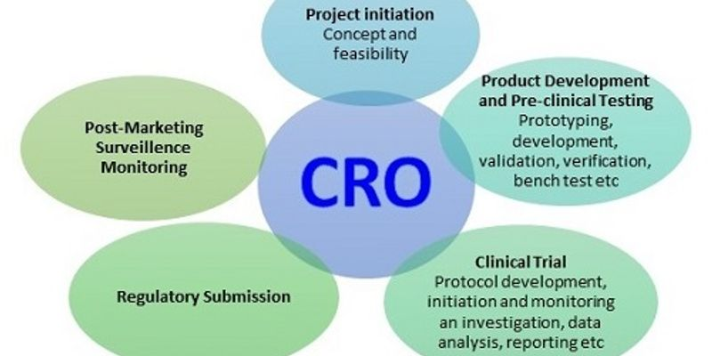
CLINICAL RESEARCH ORGANIZATIONS
Community pharmacist (clinical team leader)
Clinical research associate
Clinical trial side manager
Programming manager

Slide 22
COMMUNITY PHARMACIST (CLINICAL TEAM LEADER)
A community pharmacist is the professional who would be in direct access to the public and whose duties are widely sought after by the public and patients. He dispenses medicines with a prescription and in certain cases without a prescription where applicable (OTC drugs).

Slide 23
CLINICAL RESEARCH ASSOCIATE
As a Clinical Research Associate (CRA) you are responsible for setting up, coordinating and supervising clinical studies (trials) with medicines, medical nutrition or medical devices. You will carry out selection, initiation, monitoring and close-out visits at the participating clinical trial centers

Slide 24
CLINICAL TRIAL SIDE MANAGER
Creating and implementing study-specific clinical monitoring tools and documents. Creating and overseeing the trial budget. Identifying, enlisting, and choosing sites, and coordinating site management activities. Coordinating and supervising clinical monitoring team

Slide 25
PROGRAMMING MANAGER
Formulate, organize and monitor inter-connected projects.
Decide on suitable strategies and objectives.
Coordinate cross-project activities.
Lead and evaluate project managers and other staff.
Develop and control deadlines, budgets, and activities.
Apply change, risk and resource management.

Slide 26
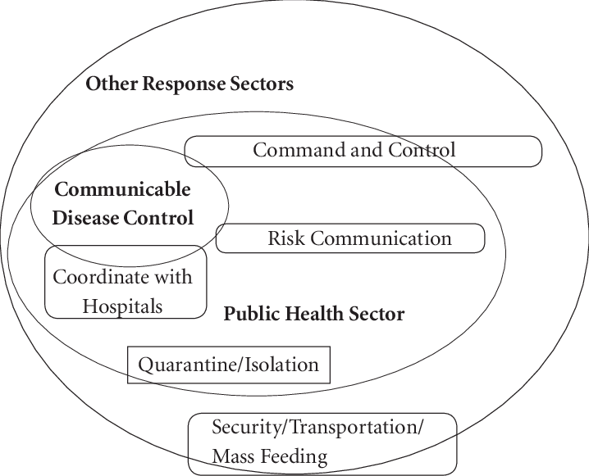
PUBLIC HEALTH SECTOR
Community pharmacist (individual pharmacist, chain pharmacist)
Projector leaders (national and international projects)

Slide 27
COMMUNITY PHARMACIST (INDIVIDUAL PHARMACIST, CHAIN PHARMACIST)
Community pharmacists are equipped to provide education and counseling to patients to address questions they may have regarding factors such as dosing, administration, storage, potential side effects, and how to taper medications for acute events

Slide 28
PROJECTOR LEADERS (NATIONAL AND INTERNATIONAL PROJECTS)
Develop team schedules and assist in the successful on boarding and training of team members. Create and communicate a clear list of expectations and goals for team members to follow. Offer emotional support to project team members and make people feel valued

Slide 29

RESEARCH AND DEVELOPMENT
PHARMACOKINETICS
PHARMACODYNAMICS
BIOAVAILABILITY
BIOEQUIVALENCE STUDIES

Slide 30
PHARMACOKINETICS
Pharmacokinetics is currently defined as the study of the time course of drug absorption, distribution, metabolism, and excretion. Clinical pharmacokinetics is the application of pharmacokinetic principles to the safe and effective therapeutic management of drugs in an individual patient

Slide 31
PHARMACODYNAMICS
Pharmacodynamics is the study of a drug's molecular, biochemical, and physiologic effects or actions. It comes from the Greek words "pharmakon," meaning "drug," and "dynamikos," meaning "power."

Slide 32
BIOAVAILABILITY
Bioavailability refers to the extent and rate at which the active moiety (drug or metabolite) enters systemic circulation, thereby accessing the site of action. Bioavailability of a drug is largely determined by the properties of the dosage form, which depend partly on its design and manufacture

Slide 33
BIOEQUIVALENCE
Bioequivalence studies are special type of studies where two drugs or two sets of formulation of the same drug are compared to show that they have nearly equal bioavailability and PK/PD parameters. These studies are often done for generic drugs or when a formulation of a drug is changed during development

Slide 34
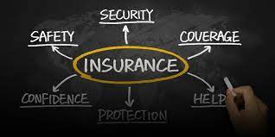
INSURANCE COMPANIES
Medical adviser (Medical insurance adviser, Medical insurance officer)

Slide 35
MEDICAL ADVISER
A Medical Advisor provides significant contribution towards the evaluation, critiquing and communication of important medical / scientific information related to a company's products. Medical Advisors assist clinical research teams and often help training and supporting the sales force

Slide 36

ACADEMICS
An academic is a member of a university or college who teaches or does research

Slide 37
HIGHEST PAYING JOBS FOR PHARM.D IN INDIA
Clinical pharmacologist
Clinical pharmacist
Clinical Fellowships
Junior research fellow/PhD (Through CSIR/NET Exams)
Project Technical officer/scientist
Jobs in clinical research
Health economics and outcomes research (HEOR)
Medical science liason
Health informatics/Biomedical informatics
Medical writing/ scientific writing
Medical affairs
Medical coding
Academics

Slide 38
Clinical pharmacologist
Type: Hospital based (NABH/TJC-JCI accredited)
Average salary: 30,000 per month (fresher)
65,000 per month (3 years experience)
Clinical pharmacist
Type: Hospital based (NABH/TJC-JCI accredited)
Average salary: 25,000 per month (fresher)
50,000 per month (3 years experience)
Clinical Fellowships
Type: Hospital/research center based
Average salary: 50,000 per month (fresher)
Depends on skill- No bar (2 years experience)

Slide 39
Junior research fellow/PhD (Through CSIR/NET Exams)
Type: project based
Stipend: 31,000 per month (first two years)
35,000 per month (Third years)
50,000 plus- no bar
Project Technical officer/scientist
Type: project based (Through ICMR, DBT, CDSA, NIV, NCL and NARI)
Stipend: 40,000 per month (Fresher)
Salary no bar (Experience based)

Slide 40
JOBS IN CLINICAL RESEARCH
Pharmacovigilence
Salary: 30,000 per month
HEALTH ECONOMICES AND OUTCOMES RESEARCH (HEOR)
Jr.Analyst: 30,000 per month (Fresher)
Salary no bar (Experience based)
MEDICAL SCIENCE LIASON
MSL: 50,000 (Fresher)
Salary no bar (Experience based)
HEALTH INFORMATICS/BIOMEDICAL INFORMATICS
Salary: 50,000 (Fresher)
Salary no bar (Experience based)

Slide 41
MEDICAL WRITING/ SCIENTIFIC WRITING
Salary: 30,000 (Fresher)
Salary no bar (Experience based)
MEDICAL AFFAIRS
Salary: 30,000 (Fresher)
Salary no bar (Experience based)
ACADEMICS
Salary: 27,000 – Assistant professor
MEDICAL CODING
Salary: 20,000 (Fresher)

Slide 42
COMPETATIVE EXAMINATIONS AFTER PHARM.D COURSE IN INDIA AND ABROAD
WHAT ARE THE EXAM COURSES AFTER PHARM.D IN INDIA
After completion of Pharm.D people work as faculty in colleges
Jobs like medical coding, medical writing, pharmacovigilence, CRA, CRO
Jobs in hospital such as clinical pharmacist, perusing PhD
There is also opportunity to appear for UGC.NET EXAM (JRF, SRF)
There is also opportunity to appear for ICMR, DBT, CDSA, NIV, NCL and NARI)

Slide 43
There is also opportunity to appear for
Indian Council of Medical Research, New Delhi (ICMR)
Department of Biotechnology (DBT)
Clinical Development Services Agency (CDSA)
National Institute of Virology (NIV)
National Chemical Laboratory – Pune
National AIDS Research Institute – Pune
Council of Scientific and Industrial Research (CSIR)

Slide 44
MOST POPULAR OPTIONS TO TACK ON TO THAT DOCTOR OF PHARMACY DEGREE, SHOULD YOU CHOOSE TO RETURN TO SCHOOL FOR MORE FORMAL EDUCATION
MBA. ...
MPH. ...
MS or PhD in Informatics. ...
JD or Law Degree. ...
MS or PhD in Pharmacology. ...
MS or PhD in Social Administrative Sciences

Slide 45
WHICH ARE THE EXAMS AFTER A PHARM.D. FOR ABROAD
After completing Pharm. D one can sit in different Licensure Examinations of different countries.
NAPLEX is the Licensure program for USA,
NAPLEX is North American Pharmacy Licensure Examination which measures your knowledge about pharmacy practice . Only 5 attempts are given to clear this exam… so you have to be very well versed in feild of pharmacy
To participate in this exam you need to require ID proofs which is clearly mentioned in NABP website ( National Association Board of Pharmacy )
PEBC(Pharmacy Education Board of Canada) conducts the exam for Canadian Licensure. Apart from these to there are many more countries like Australia, UK, Israel, UAE

Slide 46
WHAT CAN I DO AFTER PHARM D IN ABROAD?
D degree can work as:
Retail Pharmacist.
Clinical Pharmacist.
Clinical Scientist for Research.
Patient Safety Physician.
Medical Science Liaison.
Scientific Director.
Medical Writer.
Clinical and Medical Affairs Director.

Slide 47
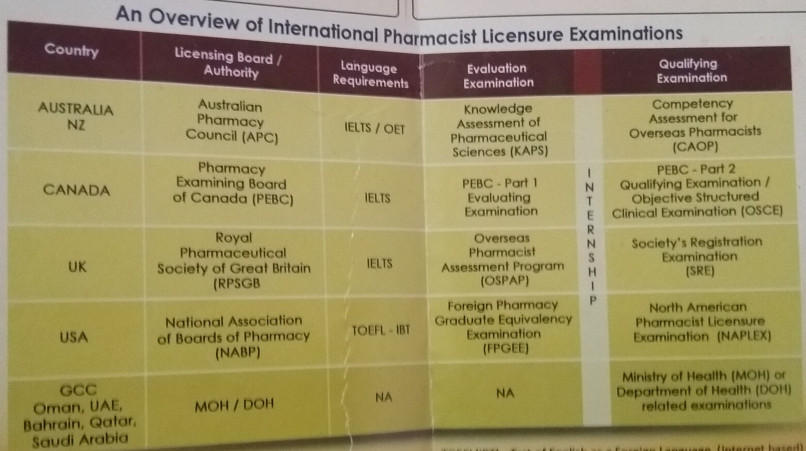

Slide 48


