Slide 1
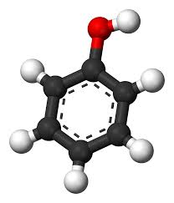

PHENOLS
PRESENTED BY
A. VAMSI M.Pharm
Department of pharmaceutical chemistry
M.A.M college of pharmacy,
Narasaraopet

Slide 2
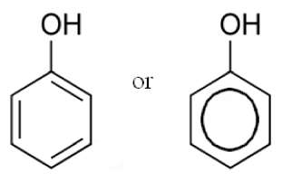
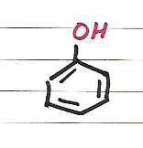
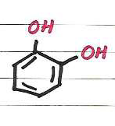
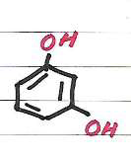
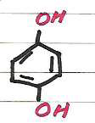
PHENOLS:
Aromatic compounds containing one or more OH groups directly attached with carbon of benzene ring are called Phenols.
Simplest phenol is also known as Carbolic Acid C6H5OH
Term Phenol is derived from an old name of benzene – Phene
Phenyl : C6H5
NOMENCLATURE OF PHENOLS
Phenol
1,2- dihydorxy benzene
O-hydroxyl phenol
(Catechol)
1,3- dihydorxy benzene
m-hydroxyl phenol
(Resorcinol)
1,4- dihydorxy benzene
p-hydroxyl phenol
(Hydroquinone)

Slide 3
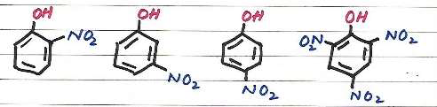
STRUCTURE OF PHENOLS:
The alcohol functional group consists of O atom bonded to sp2 hybridized aromatic C atom and H atom via σ bond
Both C-O and O-H bonds are polar
Conjugation exist between an unshared electron pair of the O and Benzene Ring
A shorter C-O bond
A more basic OH group
A more acidic OH proton
This results in, as compared to alcohols:
PHYSICAL PROPERTIES OF PHENOLS
Colorless, crystalline, poisonous solid with phenolic odor
Melting point 41oC and Boiling Point 182oC
Sparingly soluble in water forming pink solution at room temperature
Completely soluble above 68.5oC
Causes blisters on skin
Used as disinfectants and in washrooms

Slide 4
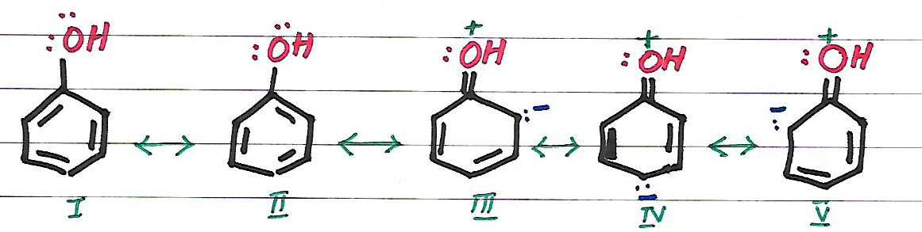
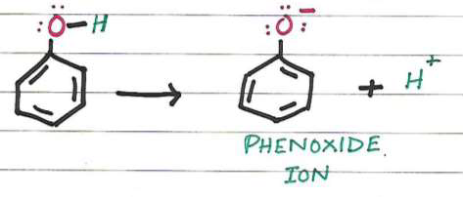
ACIDITY OF PHENOLS:
Phenols are more acidic (pKa ≈ 10) than alcohol (pKa ≈ 16-20)
Phenols are less acidic than Carboxylic acids (pKa ≈ 5)
COMPARISON OF ACIDITY OF PHENOLS AND ALCOHOLS
→Phenol exists as resonance hybrid of following structures
Due to resonance O atom acquires a positive charge and hence attracts electron pair of O-H bond leading to the release of H+

Slide 5
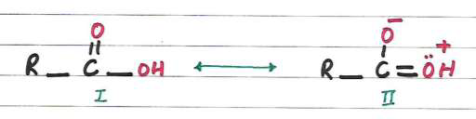
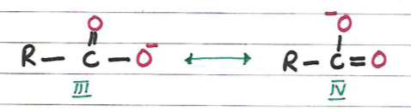
Carbon atom of C-OH group of phenol (sp2 hybridized) is more electrophilic than Carbon atom in Alcohols (sp3 hybridized)
In phenols, a greater inductive effect facilitated release of proton
Thus phenols are more acidic than alcohols because resonance is impossible in alcohols
Phenoxide is more resonance stabilized than phenol but in case of alcohol, alkoxide is not stable because there is no possibility for the delocalization of negative charge.
COMPARISON OF ACIDITY OF PHENOLS AND CARBOXYLIC ACIDS
Resonating structures of carboxylic acids:
Carboxylic acids ionize as: R-COOH → R-COO- + H+
The carboxylate anion exhibits following resonating structures:

Slide 6
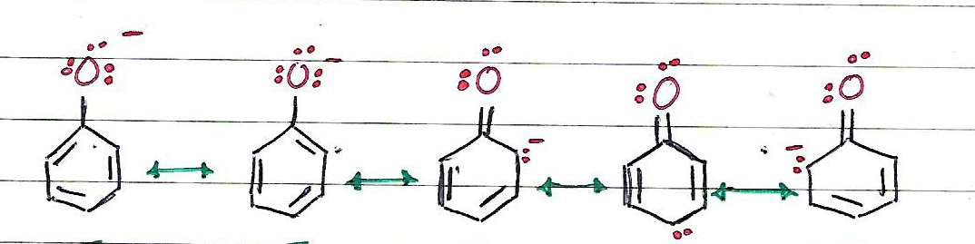
The resonating structures of RCOOH (I and II) are not equivalent and hence less stable
The resonating structures of RCOO- ion (III and IV) are equivalent and hence more stable
Thus RCOOH have tendency to undergo ionization and form more stable carboxylate ion and proton
The resonating structures of phenoxide ion are not equivalent as shown below:
The resonating structures of RCOO- ion are equivalent. Hence RCOO- ion is relatively more resonance stabilized that Phenoxide ion.
Thus a carboxylic acid is more acidic than a phenol.
RELATIVE ACIDITY ORDER OF SOME COMMON COMPOUNDS:
RCOOH > H2CO3 > C6H5OH > H2O > ROH
EFFECT OF SUBSTITUENTS ON THE ACIDITY OF PHENOLS
Electron attracting substituents tend to disperse negative charge of the phenoxide ion thus stabilize the ion and increase the acidity of phenols.
Electron releasing substituents tend to intensify the charge, destabilize the ion, diminish the resonance and decrease the acidity.

Slide 7
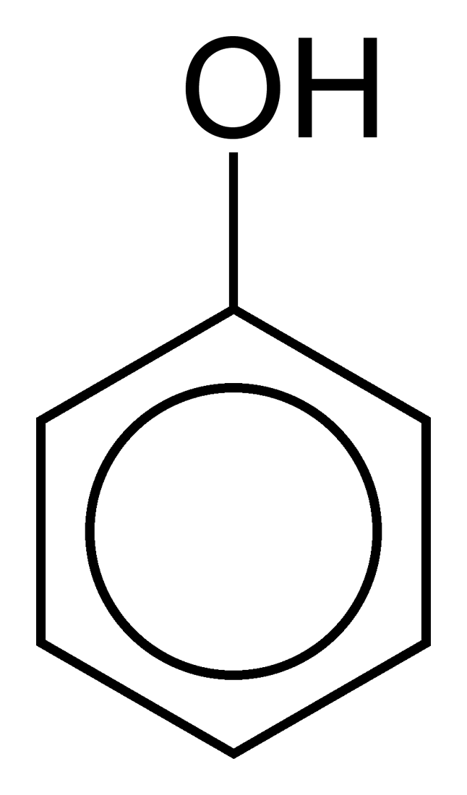
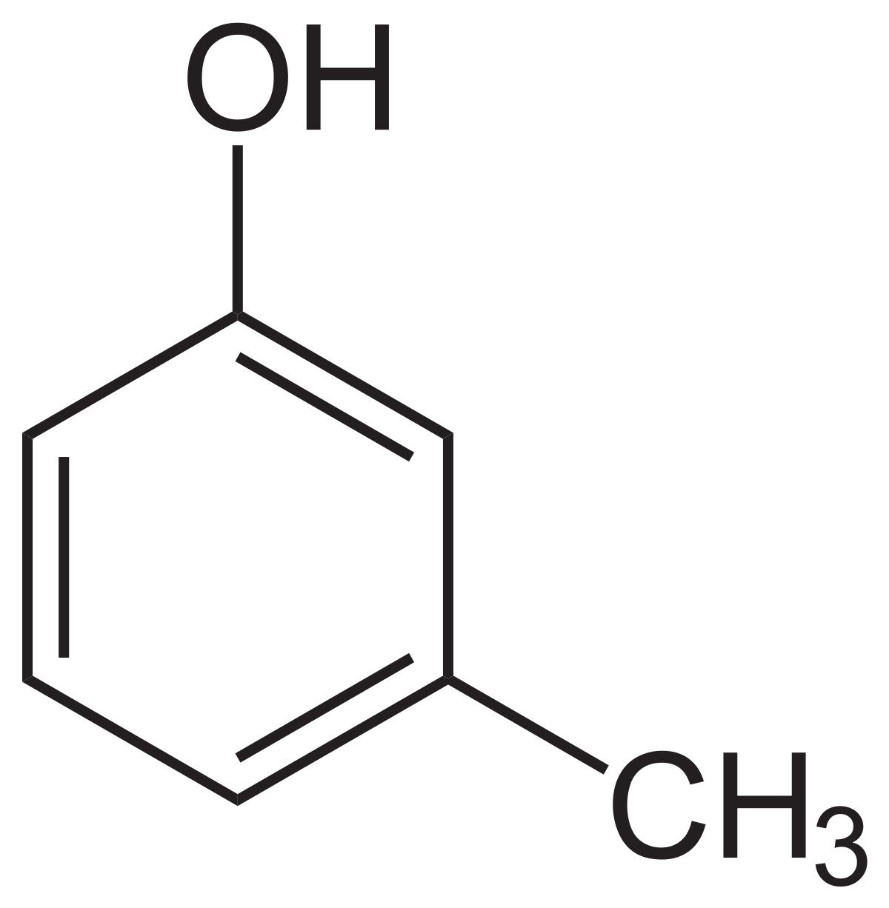
PHENOL
CRESOLS:
Hydroxy benzene
4-Methyl phenol (or) 4-Hydroxy toluene
uses:
uses:
Phenol is used as a disinfectant in household cleaners and in mouthwash
its used in gases, perfumes, soaps and toys.
its used in insulating materials, paints, rubber, inks and dyes.
Phenol is used as a disinfectant washing hands
its used in gases, perfumes, soaps and toys.
its used in insulating materials, paints, rubber, inks and dyes.
cresols can be used in phenol-formaldehyde resins
important antioxidant in foods.

Slide 8

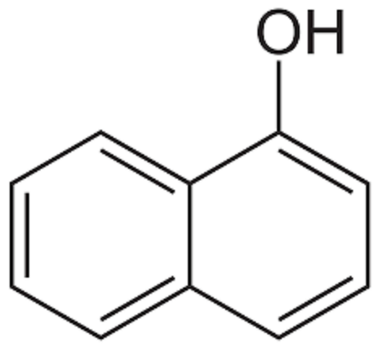
RESORCINOL: NAPHTHOLS:
Benzene-1,3-diol (or) 1,3-Dihydroxybenzene
1-Naphthol, or α-naphthol
uses:
uses:
I t is used as an antiseptic and disinfectant in topical pharmaceutical products in the treatment of skin disorders and infections such as acne, seborrheic dermatitis, eczema, psoriasis, corns, calluses, and warts
used in antidandruff agent in shampoo or sunscreen cosmetics
its used to treatment of gastric ulcers
Naphthol is uses including dyes, pigments, fats, oils, insecticides, pharmaceuticals, perfumes, antiseptics, synthesis of fungicides, and antioxidants for rubber.
it’s a molish reagent used in detecting carbohydrates

